Slide 1
Project Management 102 Pragmatic Guidelines for the Uninitiated
Michael Mundrane
IT All Staff Conference
12 March 2014

Slide 2
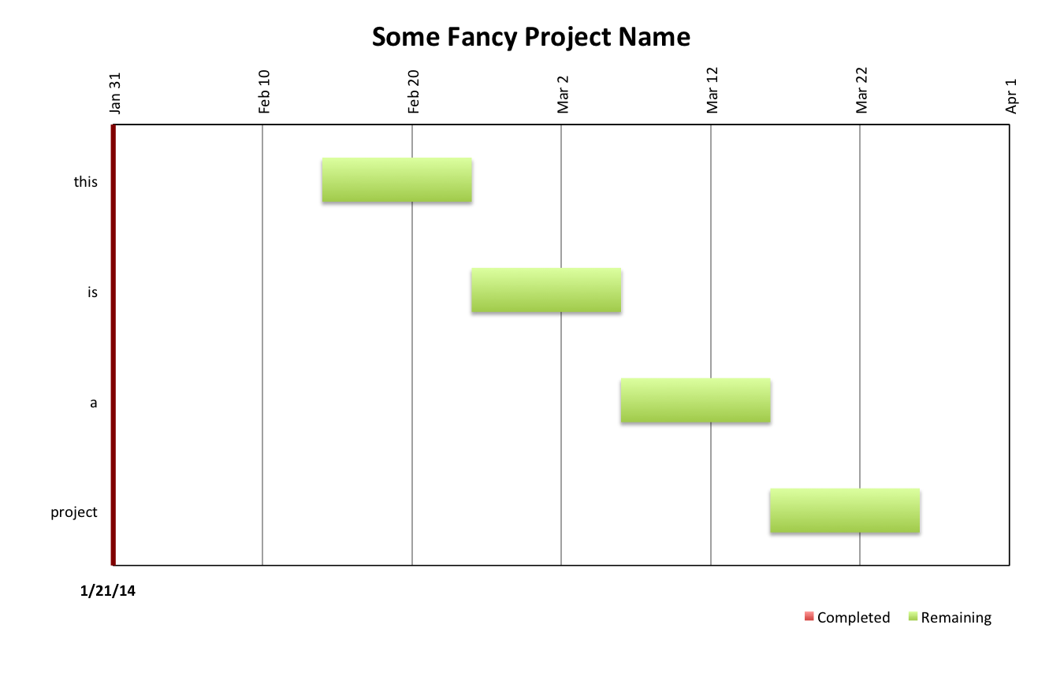
Status 1/21/2014 … ok

Slide 3
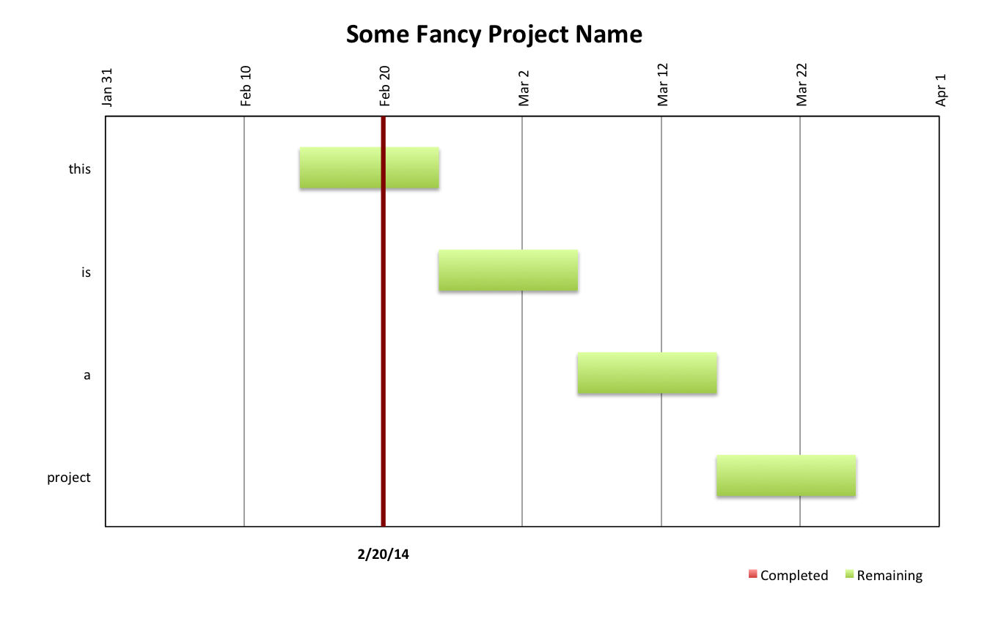
Status 2/20/2014 … hmm

Slide 4
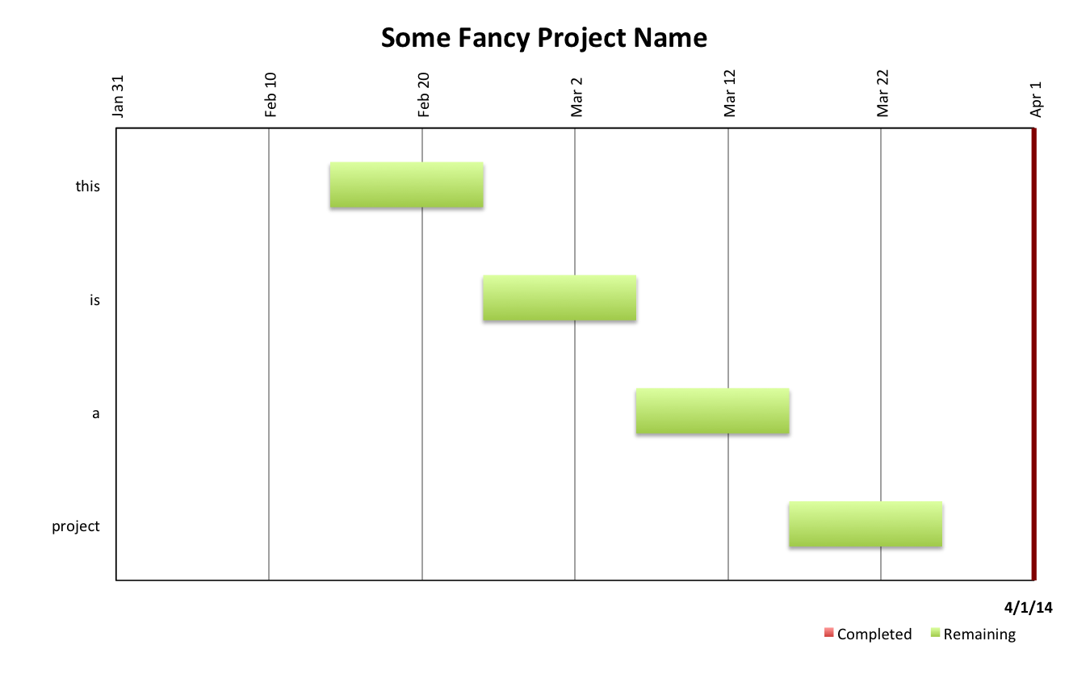
Status on 4/1/2014 … huh?

Slide 5
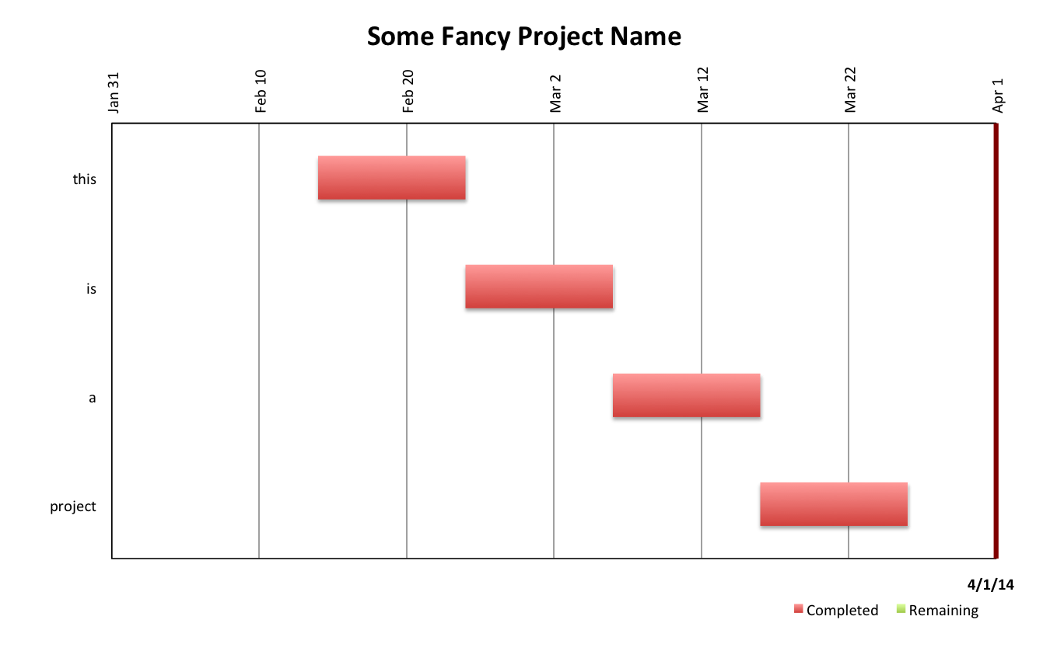
Status a Bit Later … sigh

Slide 6
Project Management Detail
Scope
Schedule
Budget
Requirements
Documentation
Milestones
Risk
Stakeholders
...
zzzzzzz
Notes:
People start checking their watches and looking at the door.

Slide 7
Rethinking This
Actually … This is not that kind of talk.
Additional process is not the solution when complexity and mismatch is the problem!
There must be a more general approach.

Slide 8
Classical Project Management
There are only two high level functions for project management.
Accurate assessment
Effective Communication
Does that really serve our needs?
What are we actually trying to manage?
Notes:
PM actually serves a narrower purpose and is not consistent with what we mean by project.

Slide 9
Proposed Project Elements
Concept
Research
Design
Planning
Staging
Execution
Review
Practical number of elements
Useful breakdown of actual
effort

Slide 10
Concept
Concept
Research
Design
Planning
Staging
Execution
Review
General idea
Alignment
Initial Assessment

Slide 11
Research
Concept
Research
Design
Planning
Staging
Execution
Review
Needs
Wants
Tradeoffs
Status of art

Slide 12
Design
Concept
Research
Design
Planning
Staging
Execution
Review
Identify
Organize
Simplify
Resolve

Slide 13
Planning
Concept
Research
Design
Planning
Staging
Execution
Review
Assess
Sequence
Schedule
Transition

Slide 14
Staging
Concept
Research
Design
Planning
Staging
Execution
Review
First phase
Not disruptive

Slide 15
Execution
Concept
Research
Design
Planning
Staging
Execution
Review
Second phase
Disruptive

Slide 16
Review
Concept
Research
Design
Planning
Staging
Execution
Review
Did we understand?
Did we design to our understanding?
Did we plan to our design?
Did we implement to our Plan?
Were we right?

Slide 17
Should/Could/Would
Concept
Research
Design
Planning
Staging
Execution
Review
Should we – good idea?
Could we – feasibility?
Would we – priority?
Notes:
Projects too often start in the wrong place.

Slide 18
Idea/Implementation
Concept
Research
Design
Planning
Staging
Execution
Review
Idea
Implementation

Slide 19
Strategic/Tactical
Concept
Research
Design
Planning
Staging
Execution
Review
Strategic
Tactical

Slide 20
Leadership/Management
Concept
Research
Design
Planning
Staging
Execution
Review
Leadership
Management

Slide 21
Development/Management
Concept
Research
Design
Planning
Staging
Execution
Review
Project Development
Project Management

Slide 22
Process
Has a role
Is not the goal
Achieves a goal
Cannot be both rigid and flexible
Is not a substitute for judgment
A simplified view of projects fits a broader set of needs.

Slide 23
Questions?
Follow up from last meeting on data storage/ security:
http://google.uconn.edu/2013/11/21/feedback-from-all-it-staff-meeting/
http://security.uconn.edu/guidance-on-cloud-services/

