Slide 1
Delivering iOS 7
How Apple’s software updates impacted network demands.
Jeff Farese & Mike Lang

Slide 2
What is the iOS 7 update?
Apple iOS is the operating system that runs on all iPhones, iPads, iPods
IOS 7 is the current major version of iOS and was released to public on September 18, 2013 at 1 PM EDT
Devices received OTA (over-the-air) update from the Internet or from a new version of iTunes, 11.1
The average size of this update was approximately 750MB

Slide 3
Why was the iOS 7 upgrade a big deal?
The iOS 7 update created an unprecedented demand on networks – a first for a software update on the Internet
Released simultaneously to all devices
130 million of 415 million eligible devices upgraded in the first 10 hours¹
Adoption rate of 50% within 48 hours²
There are ~22,000 Apple mobile devices at UCONN, ~18,000 connected on 9/18

Slide 4
What are UCONN’s average network conditions?
Baseline by using previous day, Tuesday - 9/17.
Internet Traffic Total: 24.6 TiB (~24,600 GB)
Apple Software Update (iOS & iTunes) Traffic: 0.5 TiB – 11th in Top Application Traffic, 1.9% total traffic.
Peak (2 Hour Average) Throughput: 3.75 Gbps Inbound / 0.75 Gbps Outbound

Slide 5
What change in demand did the iOS 7 release create?
Internet Traffic Total: 30.3 TiB (5.7 TiB increase, 23%)
Apple Software Update Traffic: 7.2 TiB (6.7 TiB increase, 14x) – 1st in Top Application Traffic, 23.8% total traffic.
Peak (2 Hour Average) Throughput: 5.0 Gbps Inbound / 0.75 Gbps Outbound (Bottlenecked at 5 Gbps sharply at 1 PM for 3 hours – we’ll get to why later…)

Slide 6
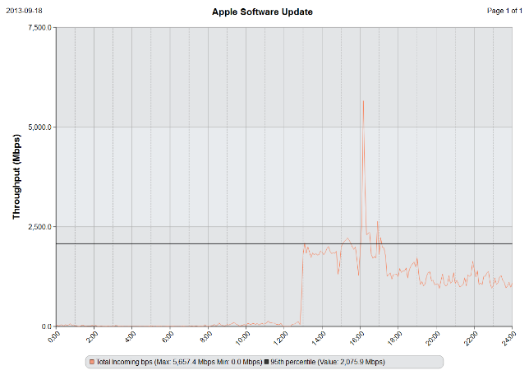
Apple Software Update 9/18

Slide 7
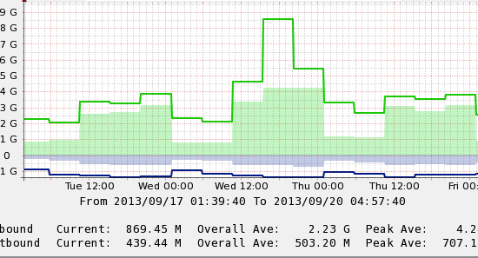
UCONN Internet Utilization 9/17 – 9/20

Slide 8
Connecticut Education Network (CEN)

Slide 9
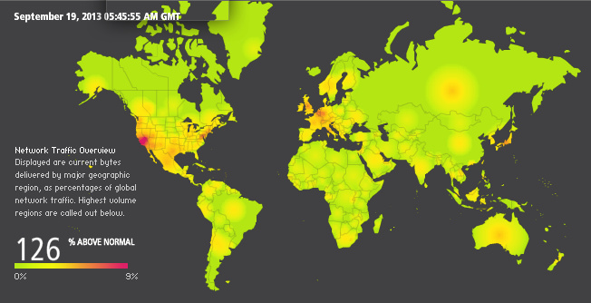
Akamai(Content Distribution)

Slide 10
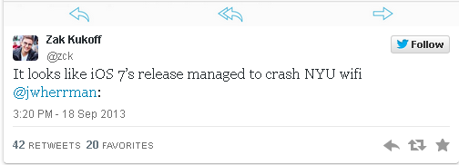
How did others do?
"In the five plus years I have been at Blue Coat, I've never seen a file update shake up the Internet like the iOS 7 update,“ Blue Coat's Jeff Brainard
Ohio State University, Michigan University, New York University, Western Connecticut State University, University of Cincinnati all had reported network issues^{3,4}

Slide 11
How did this event impact UCONN?
Overall the increased demand had little impact on network service
Noticeable but minor latency increase for Internet traffic
Internet throughput was bottlenecked at 5 Gbps for a short period of time (causing minor latency, no drops)
No customer complaints or Service Center calls!

Slide 12
Lessons Learned/Improvements
Observed unexpected 5 Gbps bottleneck on 10 Gbps design of network core – resolved 11/12/13.
Abnormal latency was quickly identified by network monitoring, allowed bottleneck to be addressed before user complaints or packet drops.
Bandwidth doubling every 24 months…

Slide 13
Sources
http://www.electronista.com/articles/13/09/20/upgrading.spike.doubled.some.isp.traffic.12.percent.worldwide.internet.usage.jump/
http://routingfreak.wordpress.com/2013/09/23/ios7s-impact-on-networks-worldwide/
http://www.usatoday.com/story/tech/personal/2013/09/19/wireless-networks-college-ios-strain/2837341/
http://9to5mac.com/2013/09/18/ios-7-downloads-causing-network-outages-at-several-school-campuses-activation-server-failures/

Slide 14
Thank You
Q & A

