Slide 1
Tidying up Technical Debt
Building an environment
that sparks ✨Joy✨!
Student Affairs Information Technology

Slide 2
Overview
What is Technical Debt?
Who are we & what do we do?
Tell a story about gloom and doom...
How did we go about fixing it?
(hint: it involves automation and containers)
Where are we now?

Slide 3
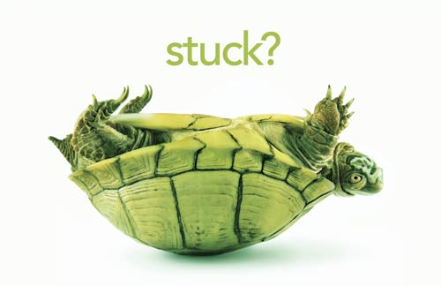
Have you ever been stuck due to technical debt?

Slide 4
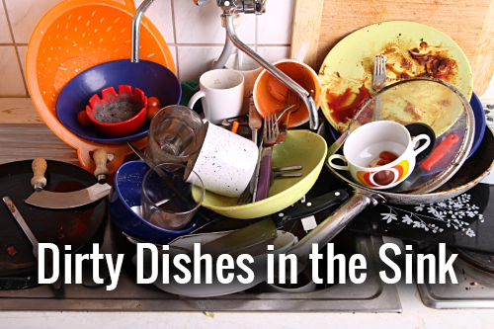
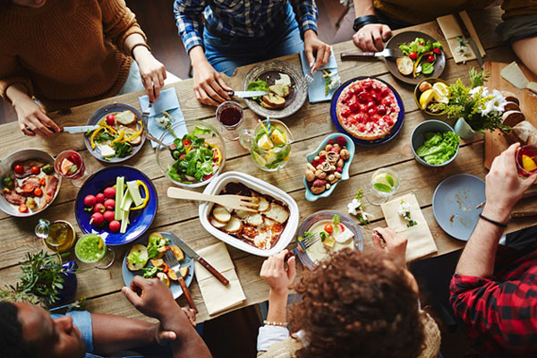
Technical debt
Notes:
Tech Debt is a bit like that feeling when you want to start cooking and there is plenty of dirty dishes in the sink.
You just want to prepare a good meal and the dishes are in the way

Slide 5
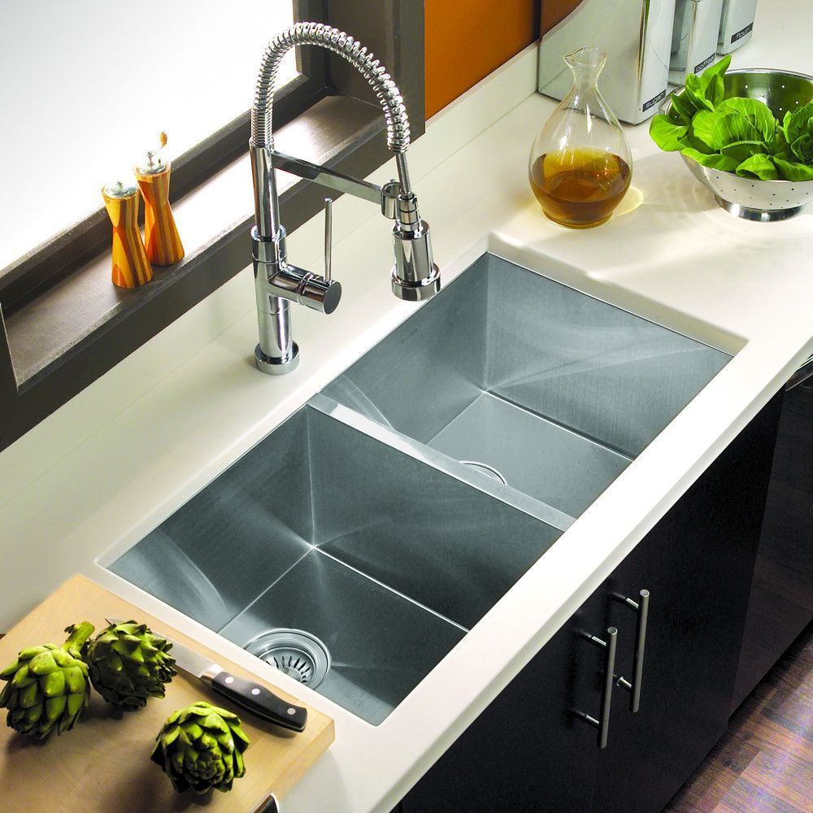
Optimize for ease
The cleaner the project environment,
the faster you’ll get to
what you’re supposed to do!

Slide 6
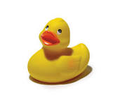
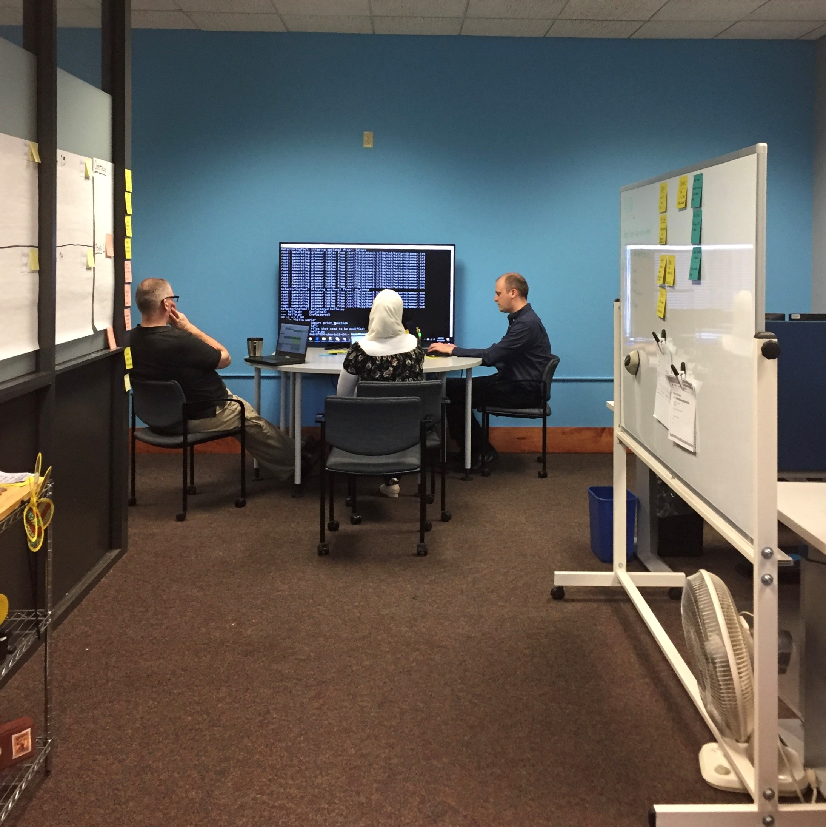
Appdev @ SAIT
One team: 5+- 1
Aya Saleh
Michael Roberson
Mike Keating
Ryan Mankus
Val Puffet-Michel
(Alumni: Tom Wood, Matt Coolbeth, Matt Desmarais)
appdev@sa.uconn.edu

Slide 7
We serve Student Affairs
6 out of 14 departments:
Center for Students with Disabilities
Dean of Students Office
Dining services
Off campus Students Services
Residential Life
One card Office
User personas:
Staff
Students
Instructors
https://studentaffairs.uconn.edu/directory/

Slide 8
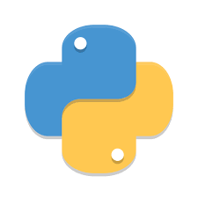
Our apps
Case / property management systems
Mostly related to interactions with Students!
Support processes like :
Readmission to UCONN
Voluntary Separation
Exam accommodation, Notetaking accommodation
Early Arrivals
~ 264,000 lines of Python
https://sait.uconn.edu/services/apps/

Slide 9
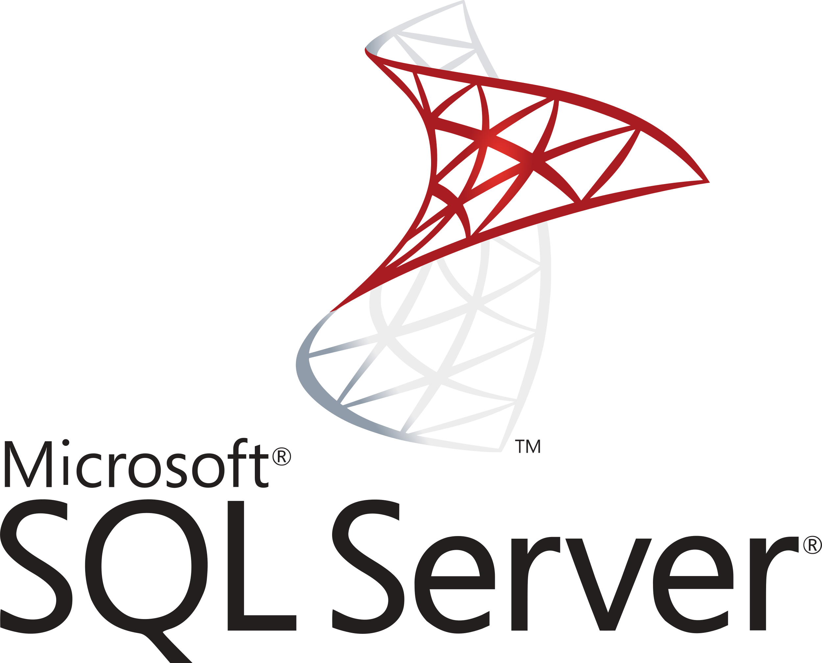
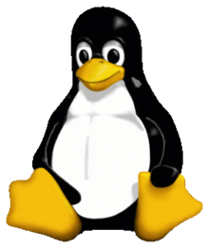
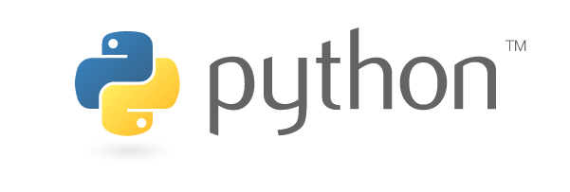
Our stack

Slide 10
Everything was fine until...
Our development environment
Made by Marc Jones circa ~ 2008.
Hosting with chroot & vms on server called Sparx
Deployment: ACDeploy - homegrown tool.
Pros:
Semi automated deployment.
Locked down and reproducible.
3 stages that worked well. (Production, UserTest, Continuous Integration)
Notes:
We could deliver software without too many dishes in the sink.

Slide 11
Sparx didn’t spark any joy...
ACDeploy and Sparx
Orphaned software, not easy to maintain or understand.
OS on Sparx and chroot
Debian Squeeze was end-of-life.
ACDeploy libraries no longer supported on newer OS.
Process to create a new Chroot is manual and fragile

Slide 12
Let’s dream!
Continuous Delivery:
Ability to get changes of all types—including new features, configuration changes, bug fixes and experiments—into production, or into the hands of users, safely and quickly in a sustainable way. ~ Jez Humble.
Notes:
predictable, routine affairs that can be performed on demand.

Slide 13
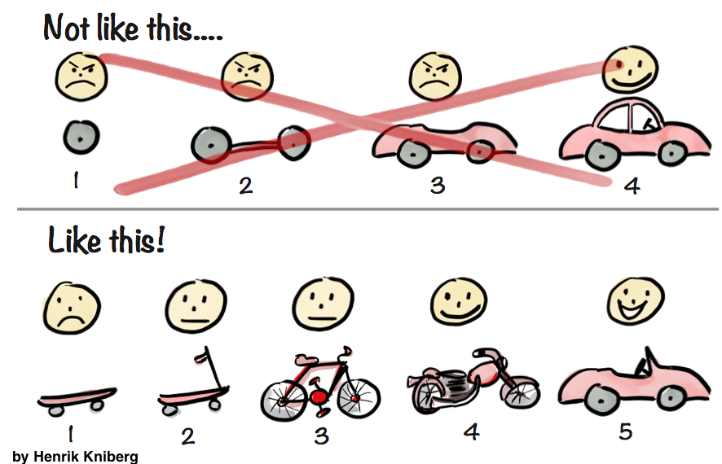
Why?
Deliver software to customers
early and often!
Smaller releases - easier to do.
Get feedback earlier
Customers get value quicker…

Slide 14
Automation to support the dream!
Build & Test automation
Deployment automation (besides database migrations)
Environment automation

Slide 15
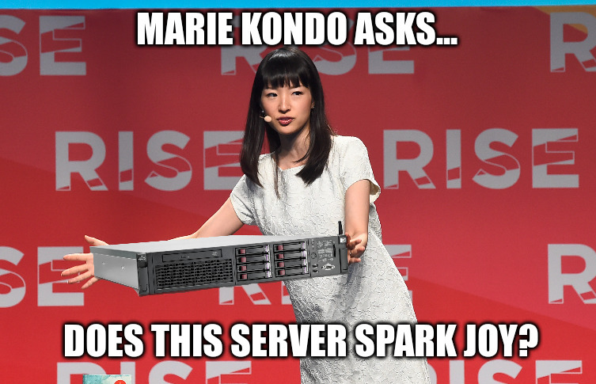
Spark Joy
Notes:
Now it is Michael’s time to tell you all about sparking joy!

Slide 16
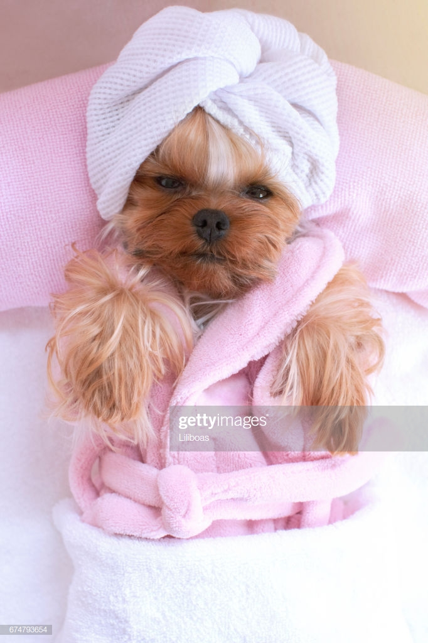
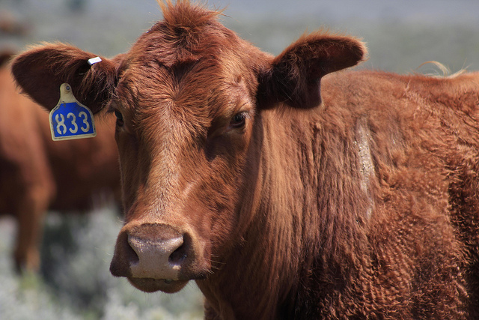
Pets or Cattle?
Notes:
“In the old way of doing things, we treat our servers like pets, for example Bob the mail server. If Bob goes down, it’s all hands on deck. The CEO can’t get his email and it’s the end of the world. In the new way, servers are numbered, like cattle in a herd. For example, www001 to www100. When one server goes down, it’s taken out back, shot, and replaced on the line.”
- Randy Bias (Cloudscaling, OpenStack Foundation)

Slide 17
Creating a herd of cattle
ACDeploy 2.0
Configuration Management Systems (Puppet, Chef, Ansible, SaltStack, etc.)
Containerization (Docker)
Kubernetes?
Docker Swarm?
Some combination of the above
Something else?

Slide 18
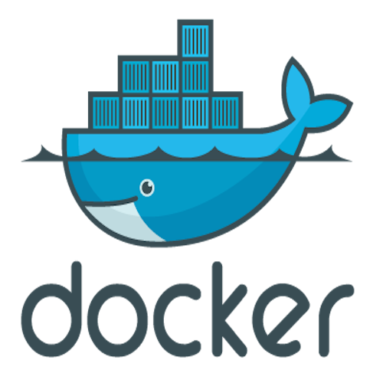
We chose Docker
With Docker Swarm
Thanks!
Tom Wood
Application Developer
James Chabot-Weingart
System Administrator

Slide 19
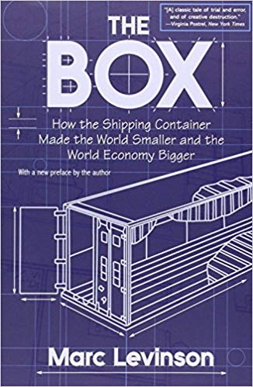
Shipping containers
Unloading ships used to take days or weeks.
Fragile cargo broke
Perishable goods spoiled
Now cargo with varied dimensions are shipped in standard-sized containers

Slide 20
What is Docker?
Platform for “containerization”
Operating-system-level virtualization as opposed to hardware virtualization (hypervisor)

Slide 21
Docker terminology
Image
An executable package that includes everything needed to run an application -- the code, a runtime, libraries, environment variables, and configuration files.
Created with a Dockerfile and the "docker build" command.
Container
A runtime instance of an image -- what the image becomes in memory when executed.
Created with an image and the "docker run" command.

Slide 22
Dockerfile
FROM ubuntu:18.04
COPY . /app
RUN make /app
CMD python /app/app.py
More examples: https://github.com/docker/labs

Slide 23
CI pipeline (Jenkins)

Slide 24
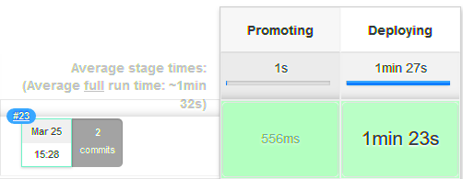
“Push button” deployment (Test)

Slide 25
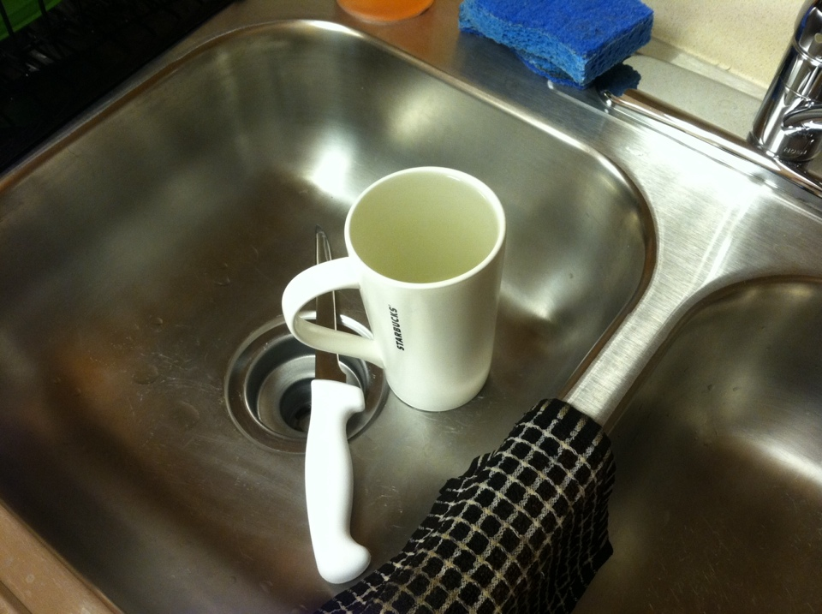
Less clutter!
All custom applications containerized Summer 2018
Creating new apps: fast and easy
Dockerfiles: easier to understand than ACDeploy
Upgraded operating system, Python, libraries
Closer to “push button” deployments in production
Onboarding new employees: few days rather than 1 month

Slide 26
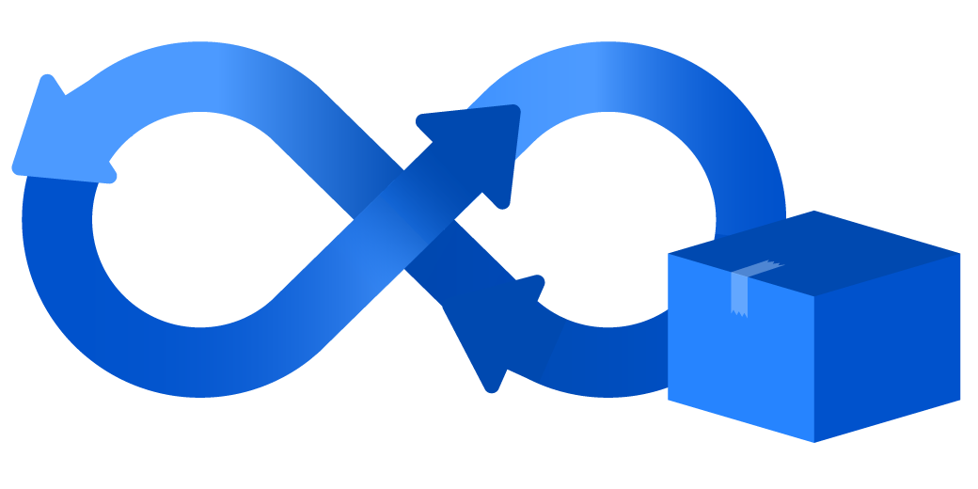
Future work
Automate database migrations
Python 3 (Python 2.7 EOL: January 2020)
Get closer to the dream: Continuous Delivery

Slide 27
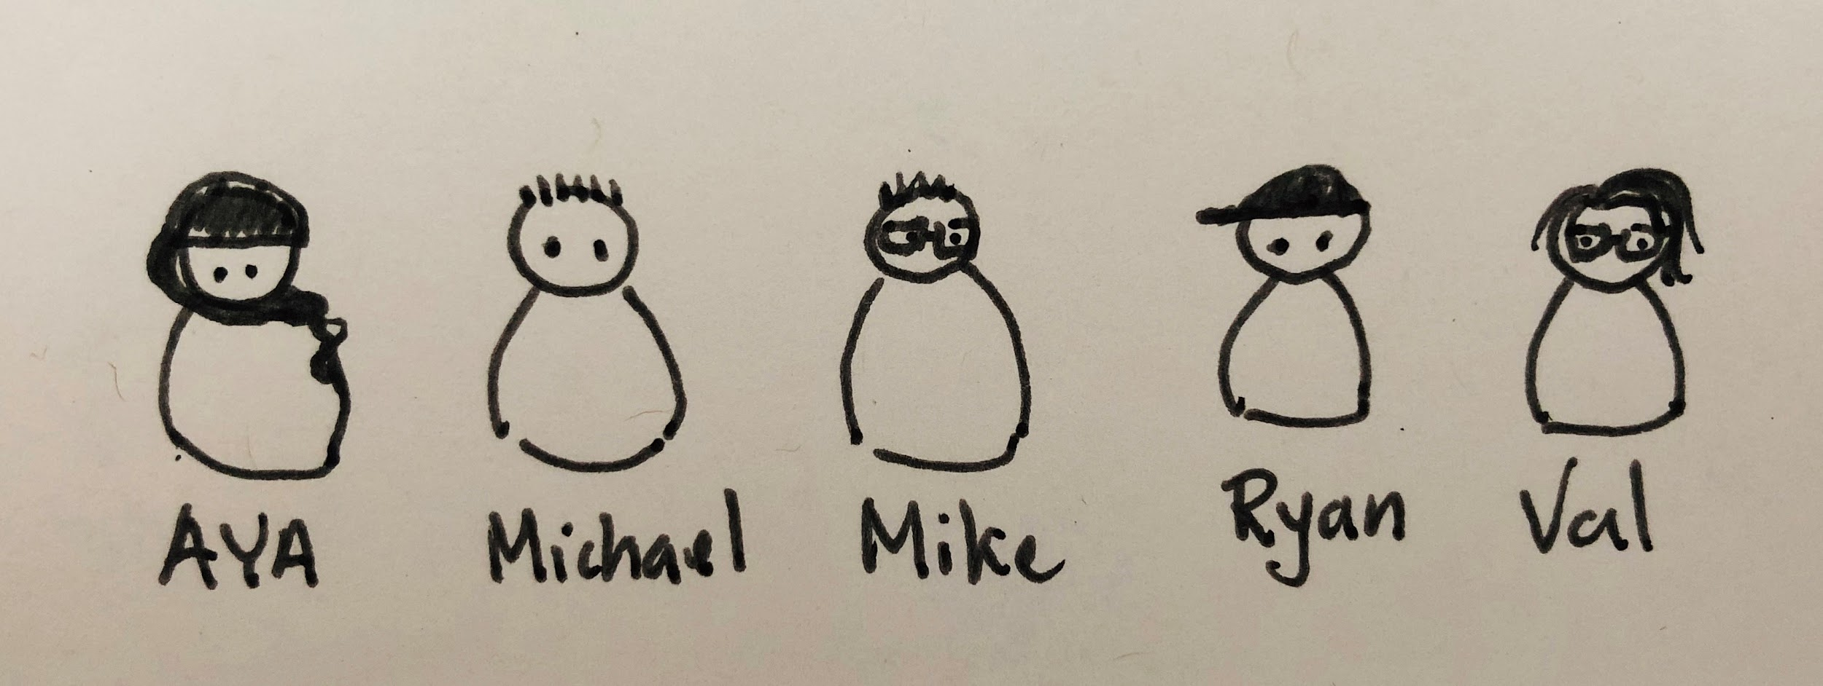
Thank you!
Interested to chat? Get a demo?
Come visit us!
Rome Commons, ground floor DG06
Michael - michael.roberson@uconn.edu
Val - valerie@uconn.edu

