Slide 1
Procurement Services
All IT Staff Meeting
September 18, 2013
Education Outreach Research

Slide 2
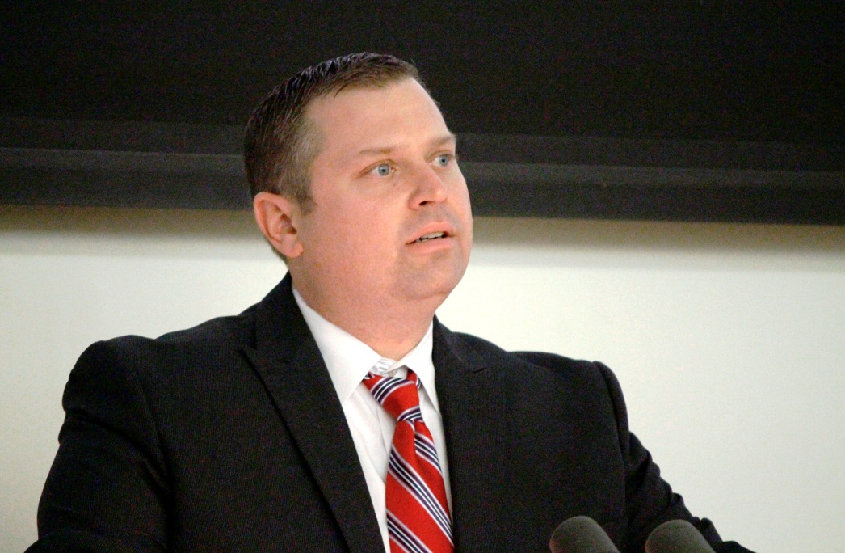
Presenters: Matthew Larson & Yolanda Villa Icea

Slide 3
Agenda
Why we are here?
Organizational Structure
Business Process Improvements
University Bidding Requirements
Enterprise Vendor Management: Rules of Engagement
Solicitation
Contract Management
Questions

Slide 4
Why are we here?
To continue an open dialogue between Procurement Services and the IT customers we serve and support.
Mission statement:
“Procurement Services supports the academic, research, and clinical missions of the University, through the strategic procurement and the judicious selection of quality supplies and services, in compliance with federal laws and regulations, Connecticut statutes and University policies along with Supplier Relationship Management and contract compliance.”
Provide an overview of current initiatives and activities that contribute to your success.
Obtain feedback to address continuous improvement opportunities in delivering a service solution that meets your business needs.

Slide 5
Organizational Structure
Procurement Services has been redesigned to proactively support the University mission through a more collaborative approach centered upon a more
effective utilization
of resources and talent.

Slide 6
Business Process Improvements
"U"-Count is a university-wide initiative challenged to explore cost containment opportunities, redefine business processes, and re-evaluate the way in which the University procures goods and services while maintaining the quality and integrity of our Procurement Policies.
Renegotiation of pricing with existing vendors
Rebidding of contracts
Pooling spend and leveraging volume across the University campuses [Ex. Software licensing]
Identifying lower cost options and standards, where applicable, while maintaining quality of product and/or service
Streamlining procurement processes to increase efficiencies.

Slide 7
Business Process Improvements
Streamlined procurement experience through deployment of
e-Procurement Solution such as “Husky Buy.”
Commitment to a proactive, strategic sourcing and contracting approach
Analytical and research capabilities
Enhanced contracting depth and support

Slide 8
University Bidding Requirements
Bidding Thresholds
The University must adhere to legislative requirements with regard to bidding C.G.S. 10a-151b
Circumventing these requirements exposes the University to compliance, financial and reputational risk.
Main bidding guidelines:
Purchases Requiring Informal Bidding Process
Purchases Requiring Formal Bidding Process
Notes:
Purchases Requiring Informal Bidding Process
Purchase of commodities or services not available against an existing State, University, or
Consortia contract with an estimated total value exceeding $10,000 shall be based upon a
minimum of three (3) competitive quotations.
Informal bids are called Request for Quotation (RFQ)]
Purchases Requiring Formal Bidding Process
Purchase of commodities or services with an estimated value of fifty thousand
dollars ($50,000) or more, shall be based upon the solicitation of formal competitive bids.
Formal bid types include:
Invitation to Bid (ITB)
Request for Proposal (RFP)
Request for Qualification (RFQual)]

Slide 9
University Bidding Requirements
Purchases Requiring Informal Bidding Process
Purchase of commodities or services not available against an existing State, University, or
Consortia contract with an estimated total value exceeding $10,000 shall be based upon a
minimum of three (3) competitive quotations.
Informal bids are called Request for Quotation (RFQ)
Purchases Requiring Formal Bidding Process
Purchase of commodities or services with an estimated value of fifty thousand dollars ($50,000) or more, shall be based upon the solicitation of formal competitive bids.
Formal bid types include:
Invitation to Bid (ITB)
Request for Proposal (RFP)
Request for Qualification (RFQual)
Procurement Services team members can help determine most appropriate type of bid event in support of business need.

Slide 10
Enterprise Vendor Management Rules of Engagement
I. Solicitation Phase:
Engaging Procurement Services in internal strategic planning meetings and vendor meetings where new or additional purchasing needs are discussed.
Procurement role:
Single point of contact for vendors during purchasing process
Coordinate with:
Stakeholder - Subject Matter Experts
Other functional areas (Finance, Legal, Risk Mgmt. etc.)
Stakeholder role:
Respect and protect UCONN’s Intellectual Property and existing contract relationships and information.
Restraint from offering or accepting gifts¹
¹ Details at Office of the State Ethics: www.ct.gov/ethics/site/defaults.asp

Slide 11
Enterprise Vendor Management: Rules of Engagement
II. Contract Management Phase:
Stakeholder as “Relationship Manager (“RM”) and Procurement in supporting role: strategic planning meetings for added/changing needs and for notification process when a relationship ends.
RM oversights, directly monitors the services provided: location, how the services will be managed throughout the tenure, including: day-to-day ops, which UCONN organizations are impacted, transaction volume and how services are computed.
RM protects the overall UCONN interest, including, but not limited to:
Data elements that vendor access, stores and receives
Protects UCONN’s Intellectual Property and notifies about potential breach exposure
Manages performance and scorecards on Service Levels / Key Performance Indicators
Ensures UCONN certification/policy requirements are met throughout the term of contract:
System authentication and authorization
Architecture for developed applications
Infrastructure protection
Physical security.

Slide 12
QUESTIONS: Open Forum
Thoughts? Suggestions? Comments?

