Slide 1
IT All Staff Conference September 29, 2014
Please sign in and create a name tag.

Slide 2
Office 365 Project
IT All Staff Conference
September 29, 2014
Josh Boggis
Meera Nair

Slide 3
Overview
Hosted services in the cloud - Office 365
OneDrive - personal storage
Exchange 2013
Lync 2013
SharePoint 2013
Microsoft Office 2013

Slide 4
Services Offered
Standard :
50 GB for Mailbox size
1 TB of Personal storage, 10 GB max per file
Create / Edit / Share Office and OneNote files via a web browser or desktop
Enhanced :
Includes options in Standard
Create / Edit / Share Office and OneNote files from mobile devices
Unlimited Online E-mail Archive
Subscription to Office for up to 5 PCs/Windows tablets/Macs per user

Slide 5
Why This Decision?
Mainstream support ends 1/15/2015 for Exchange 2010
Larger mailboxes and storage allocations
Improved Collaboration
Ability to offer advanced services (unlimited archiving, mobile device editing, 5 copies of Office)
Ability to quickly offer extended services (Lync, SharePoint)
Becoming Microsoft’s preferred method of delivery
Easier to keep pace with current versions of software

Slide 6
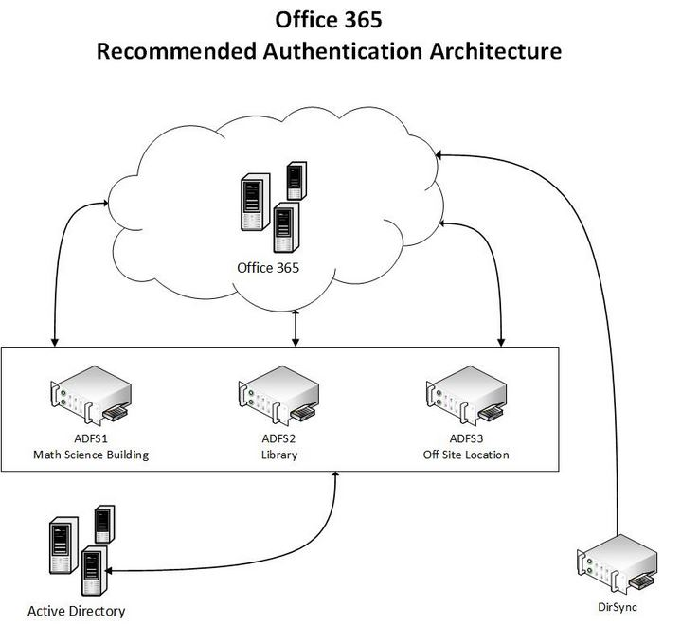
Design

Slide 7
Service Impact
30 Messages/Minute with Recipient Rate Limit of 10,000/day → SMTP Service will be offered for mass mailing
25MB attachment limits → Larger attachments can be accessed via OneDrive

Slide 8
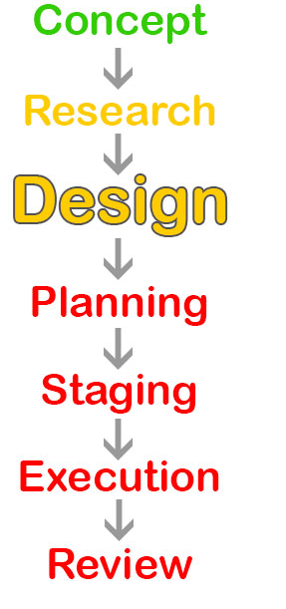
Next Steps
Finishing up research phase
Working on the design
Investigating the toolset
Finalizing the architecture

Slide 9
Thank you
Questions / Feedback
Website: Office365.uconn.edu Email: 365@uconn.edu

