Slide 1
IT Risk Management
IT RISK MANAGEMENT
ITS All Staff Meeting
Jason Pufahl, CISO
July 27, 2018

Slide 2
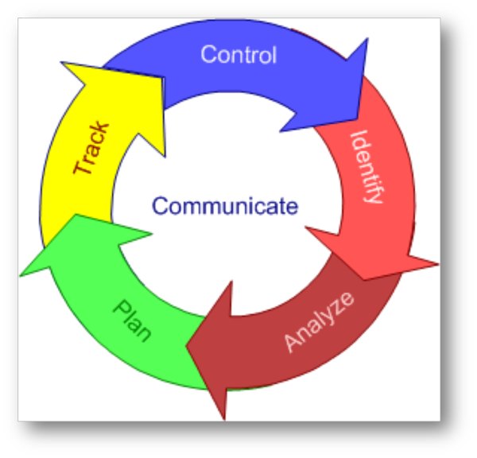
Current Program
Risk Assessment Policy
2016 Developed Risk Assessment Questionnaire
Reporting and Analysis

Slide 3
What’s Changed
Redesigned questionnaire based off of NIST cybersecurity framework
SimpleRISK: Governance Risk Management and Compliance Tool
Track departmental risks
Provide institutional insight
Plan mitigations

Slide 4
What to Expect
Mid August we will distribute link to the SimpleRISK questionnaire
Complete questionnaire by October 1, 2018
Designed to be simple to complete
28 basic questions, expanded based on responses to contingency questions
Helpful links will provide contextual information as appropriate
University policies and/or standards are referenced throughout ensuring accurate understanding

Slide 5
Security Visibility
Assess the security controls across the organization
Determine enterprise-level risks prioritize projects accordingly
Create action plan

Slide 6
Thank You
Questions?
Jason Pufahl
Chief Information Security Officer
Information Technology Services
Jason.Pufahl@uconn.edu

