Slide 1
IT All Staff
M. Mundrane
16 March 2018

Slide 2
Customer

Slide 3
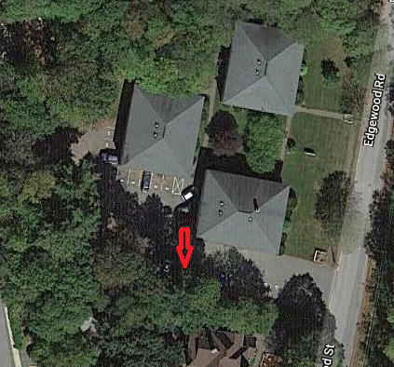
Parking

Slide 4
Conference

Slide 5
Community
Common history? … policy? … interests? … characteristics?

Slide 6
Community
A group of people with a deference to individual value and a shared commitment to common, beneficial outcomes.

Slide 7
Integrity
Visible vs. Hidden
It is easy to appear virtuous when your actions take place in secret.

Slide 8
Integrity
Right vs. Wrong
It is easy to do the right thing when it costs you nothing.

Slide 9
Integrity
Ego vs. Outcome
It is easy to advocate for things that benefit you personally.

Slide 10
Integrity
A quality of being forthright, honest, and principled with statements and actions that are mutually consistent and clear despite personal costs.

Slide 11
Consideration
January 1, 2014

Slide 12
Outcomes

Slide 13
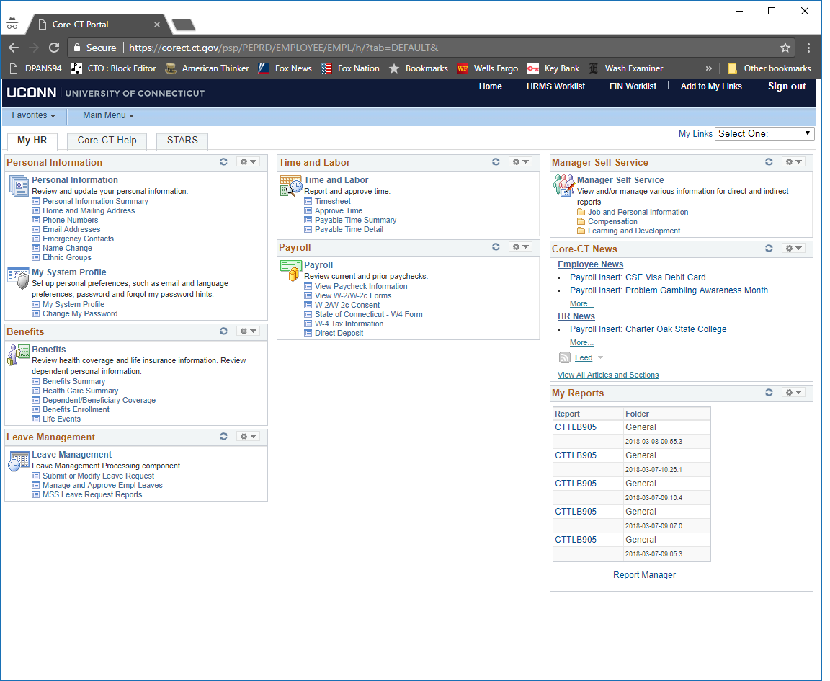
Service

Slide 14
Contribution
A positive contribution is one that produces a beneficial or useful outcome from the perspective of the recipients.

Slide 15
Attitude
Personally invest in providing the best practical outcome for the group, the organization, and the institution.
Staff

Slide 16
Attitude
Actively ensure the success of each and every individual.
Manager

Slide 17
Attitude
Envision a better future that is attainable and do what is needed to bring the organization there.
Leader

Slide 18
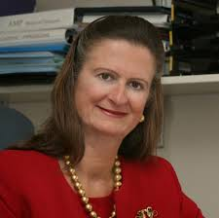
Attitude
Christine Haska
April 1951 – July 2017

Slide 19
Future
Identify, implement, facilitate, operate, and evolve impactful enterprise systems, services, and capabilities that effectively support all aspects of the institutional mission: research, teaching, learning, clinical care, and outreach.
Community
Integrity
Contribution
Attitude

Slide 20
Future
Identify, implement, facilitate, operate, and evolve impactful enterprise systems, services, and capabilities that effectively support all aspects of the institutional mission: research, teaching, learning, clinical care, and outreach.
Central
Independent
Community
Integrity
Contribution
Attitude

Slide 21
Future
Identify, implement, facilitate, operate, and evolve impactful enterprise systems, services, and capabilities that effectively support all aspects of the institutional mission: research, teaching, learning, clinical care, and outreach.
Central
Embedded
Directed
Independent
Community
Integrity
Contribution
Attitude

Slide 22
Future
Identify, implement, facilitate, operate, and evolve impactful enterprise systems, services, and capabilities that effectively support all aspects of the institutional mission: research, teaching, learning, clinical care, and outreach.
Central
Embedded
Directed
Community
Integrity
Contribution
Attitude

Slide 23
Thank You
Questions?
Community
Integrity
Contribution
Attitude

Slide 24
Copyright
Copyright © Michael R. Mundrane 2018. This work is the intellectual property of the author. Permission is granted for this material to be shared for non-commercial, educational purposes provided that this copyright statement appears on the reproduced materials and notice is given that the copying is by permission of the author. To disseminate otherwise or to republish requires written permission from the author.
Community
Integrity
Contribution
Attitude

