Slide 1
High Availability Strategy
September 29, 2014
Improving Service Through Diversification

Slide 2
Our High Availability Strategy
High availability: Establish a structure that ensures a sustainable, robust, and secure network/infrastructure/data center with the following components:
Implementation and operation, including a lifecycle model;
; and
Disaster recovery
Location diversity

Slide 3
Our Goals
Minimize disruptions & unplanned service downtime
Avoid utility outages and system failure
Improved Recovery Time Objective (RTO)
Improved Recovery Point Objective (RPO)

Slide 4
Our High Availability Strategy Is Not…
A specific technology
One-size fits all
A pure infrastructure problem
Over-engineering
Data backup strategy

Slide 5
Our Approach
Location diversity
Initial focus on large academic systems (HuskyCT, SA)
Redundant systems
Data(base) replication
Eliminate single points of failure
Virtualize to minimize footprint

Slide 6
Locations
2 locations on the Storrs campus
Paired data centers, joined by layer 2-adjacent network
Primary location: MSB Data Center
Secondary location: Homer Babbidge Library (HBL) Data Center
Future expansion (5E phone switch room)

Slide 7
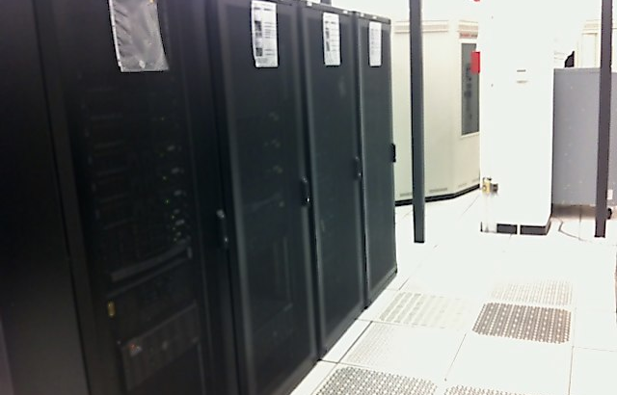
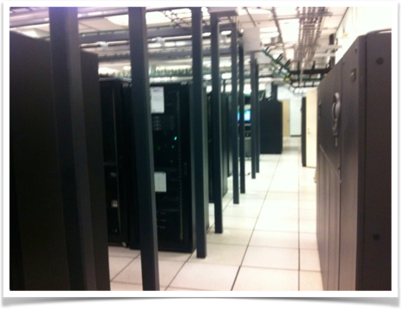
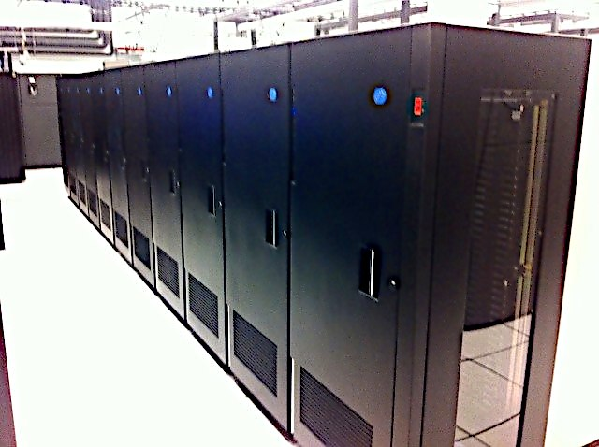

Slide 8
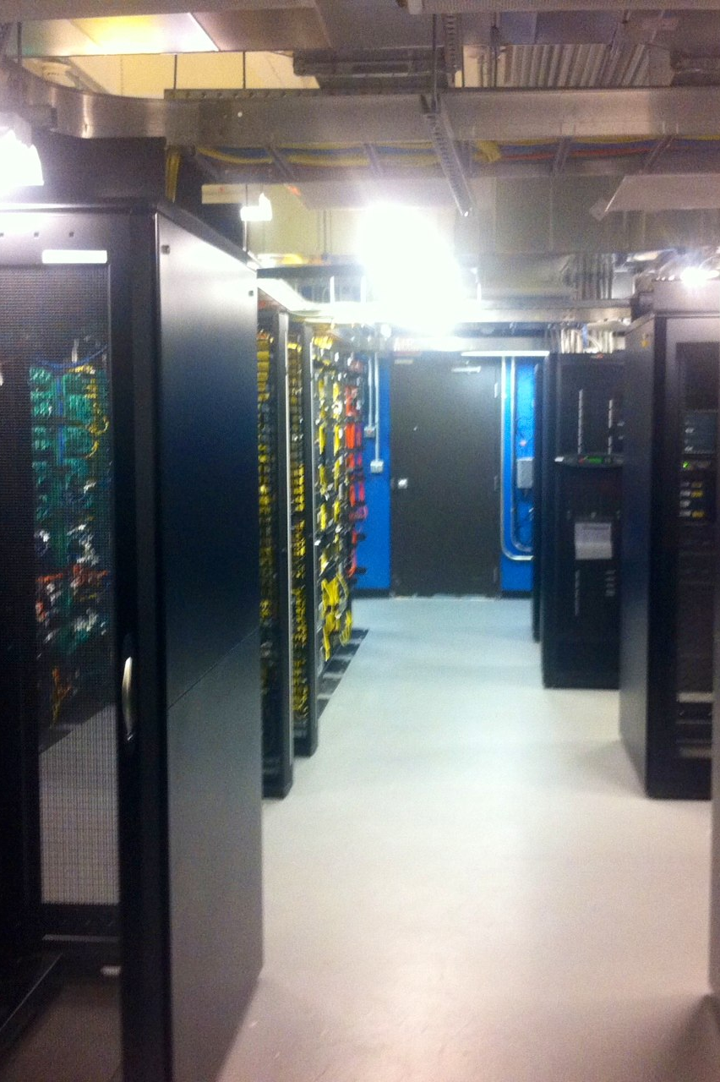
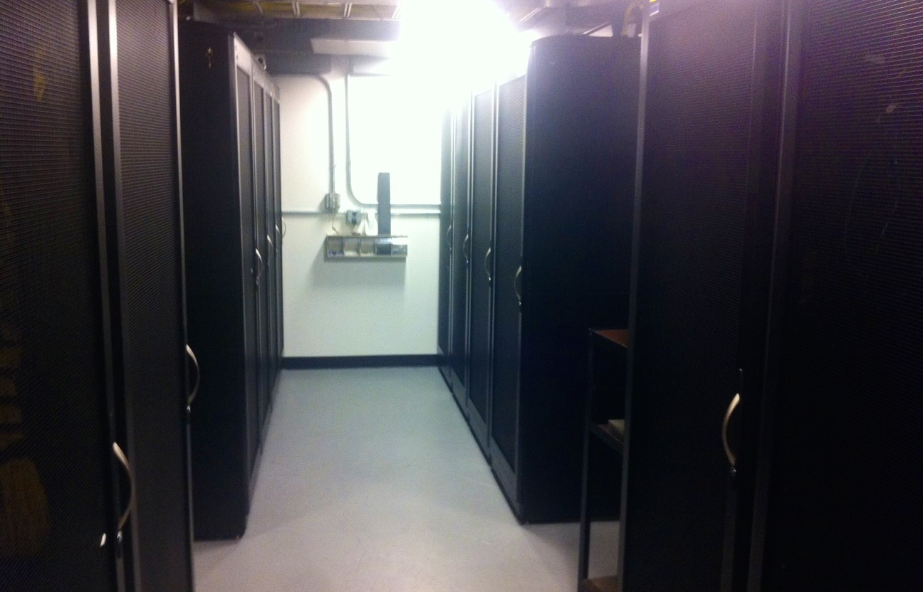
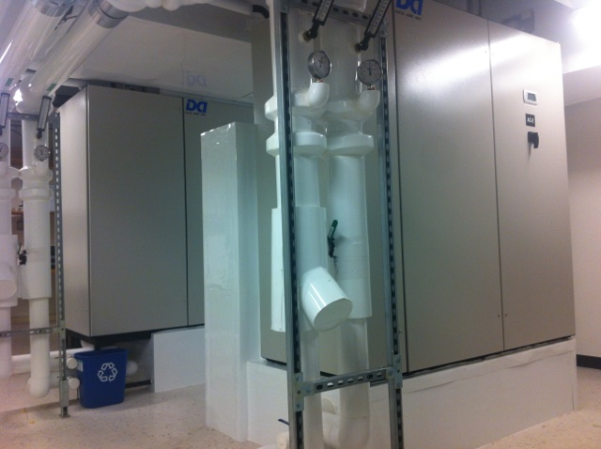

Slide 9
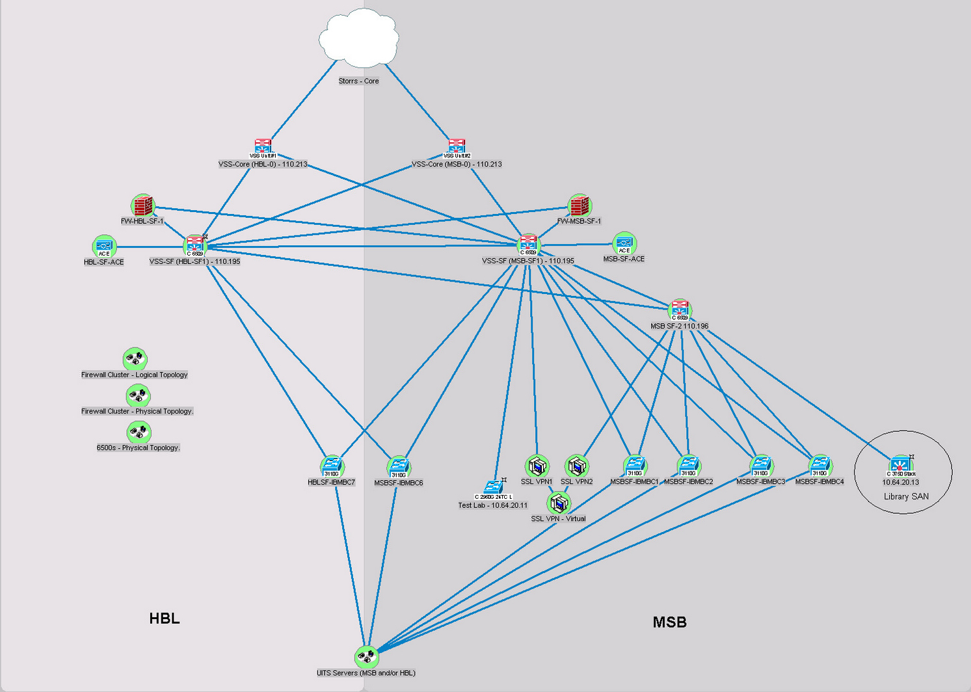
Topology of Storage Layout

Slide 10
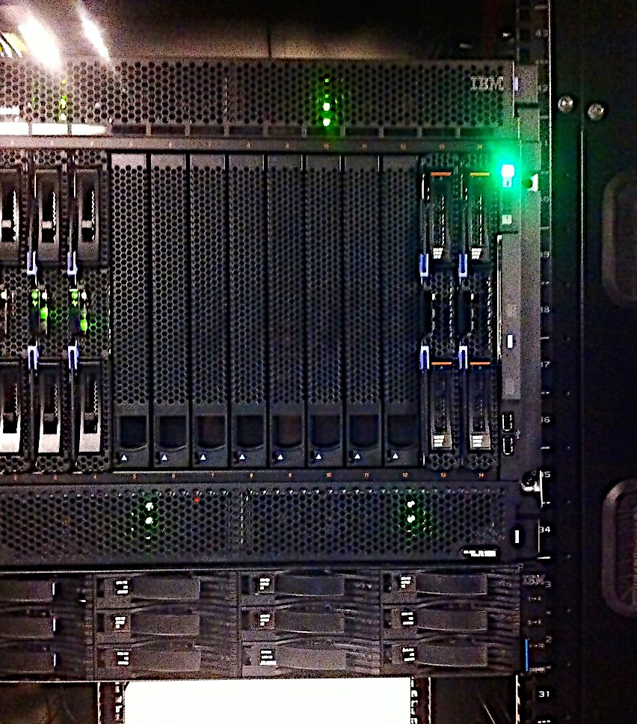
Current Equipment
IBM H-Series Blade Center Chassis
6 IBM HS23 Blades
IBM Power 750 Express server
138 TB block storage
1 Gbps network links to BladeCenter (10 Gbps network infrastructure)
VMWare VSphere 5.1 update 2

Slide 11
Timeline
Currently: Exchange
October:
HuskyCT
FlexLM
November:
Student Admin
Active Directory
CAS/LDAP
December:
Mail Infrastructure
Moving Forward
Aurora
Splunk

Slide 12
Issues and Unknowns
Data replication
Firewall single point of failure
Backups
Failover/Fail-back scenarios
Application Capabilities

Slide 13
Questions?

