Slide 1
Framework to Promote Data Driven Decision Making
IT All Staff Conference
10/31/2019
M. Mundrane

Slide 2
Data Driven Decision Making
Data
Big Data
Cloud
Big data in the cloud
… You get the idea

Slide 3
Data Driven Decision Making
The process of making organizational decisions based on the analysis of actual information or data rather than intuition or observation.
Does anybody think this is not a good idea?

Slide 4
Concept
Decision
Data
What could possibly be easier?

Slide 5
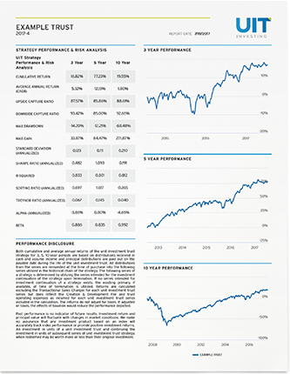
Reality
Decision
x x x x x
x x x
Business
Process
x x x x x
x x x
Transaction
x x x x x
x x x
Broker
Systems
x x x x x
x x x
Reporting
x x x x x
x x x
Reports
x x x x x
x x x
Reporting
Interpret
x x x x x
x x x

Slide 6
Impact of Layers
Decision
Each layer has an Impact on the layer beneath it in the stack.
Issues compound by impacting all subsequent layers.
Process
Transaction
Broker
Reporting
Reports
Interpret

Slide 7
Inputs
Decision
Process
Inputs drive all results.
Inputs come at the top of the stack.
Transaction
Broker
Reporting
Reports
Interpret

Slide 8
Outcomes
Decision
Results should be outcome based.
Outcomes are assessed at bottom of the stack.
Process
Transaction
Broker
Reporting
Reports
Interpret

Slide 9
Data Stack Issues
Fidelity issues with each layer.
Problems compound.
Large separation between inputs and outcomes.
No awareness of the connection.
Inputs are often arbitrary.
Outcomes are often happenstance.
Stacks are domain specific.

Slide 10
Data Governance
Decision
Process
x x x x x
x x x
Governance
Transaction
x x x x x
x x x
Broker
Reporting
Reports
Interpret

Slide 11
Introduce Outcome Compromises
Decision
Drive compromises back through the stack from outcomes to inputs.
Extract immediate value from each step.
x x x x x
x x x
Process
x x x x x
x x x
Transaction
x x x x x
x x x
Broker
x x x x x
x x x
Reporting
x x x x x
x x x
Reports
x x x x x
x x x
Interpret
x x x x x
x x x

Slide 12
Apply Input Corrections
Decision
Drive corrections back through the stack from inputs to outcomes.
Improve stability with each step.
Process
Transaction
Broker
Reporting
Reports
Interpret

Slide 13
Domain Approach
Select a domain.
Identify elements.
Define specific outcomes.
Drive compromises from outcomes to inputs.
Vet compromises with domain authority.
Drive corrections from inputs to outcomes.
Repeat

Slide 14
Thank You
Questions?

Slide 15
Copyright
Copyright © University of Connecticut Information Technology Services 2019. This work is the intellectual property of the author. Permission is granted for this material to be shared for non-commercial, educational purposes provided that this copyright statement appears on the reproduced materials and notice is given that the copying is by permission of the author. To disseminate otherwise or to republish requires written permission from the author.

