Slide 1
Data Center Stabilization
University ITS
September 18th 2013
RC Teal

Slide 2
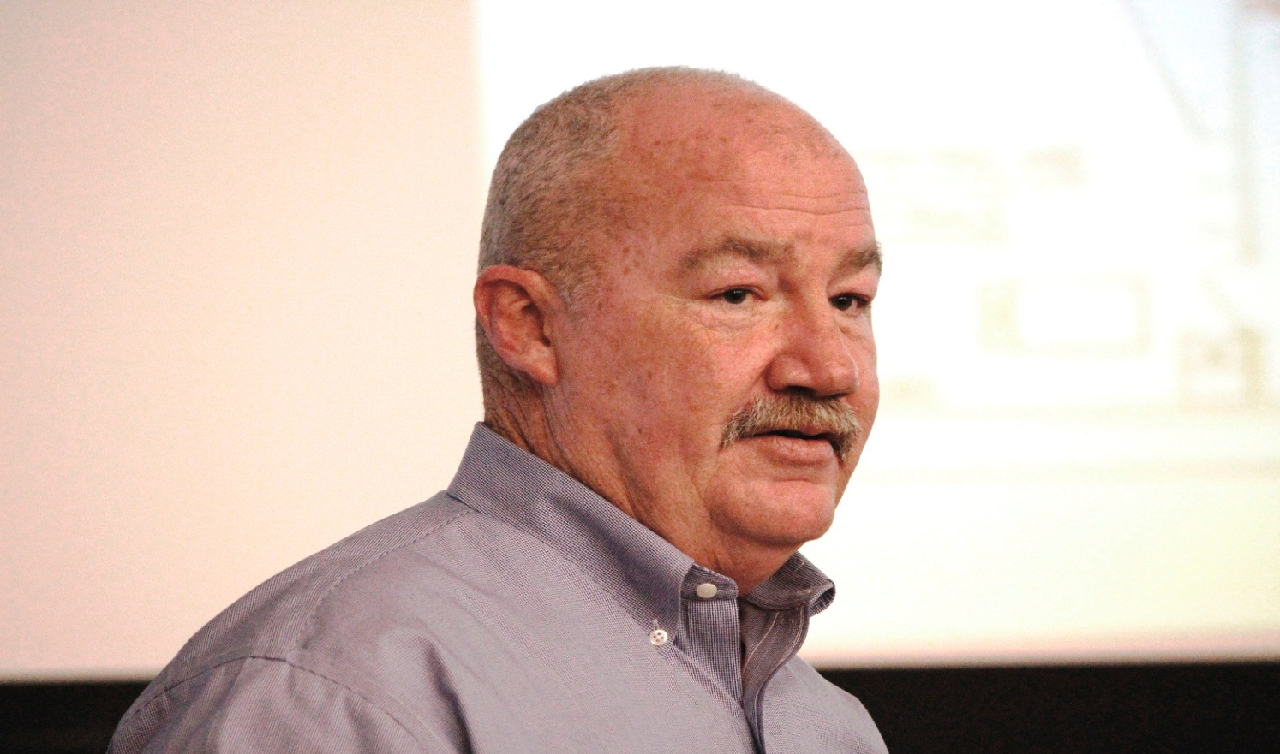
Presenter: R. C. Teal
Data Center Stabilization

Slide 3
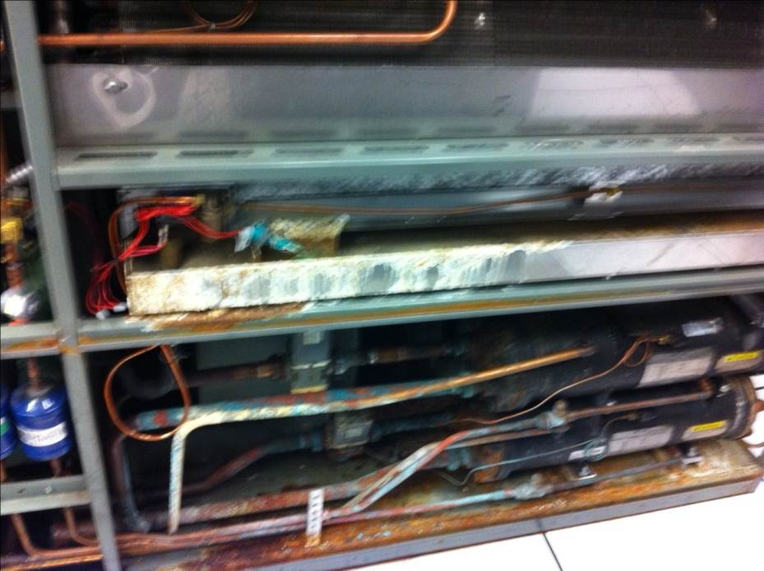
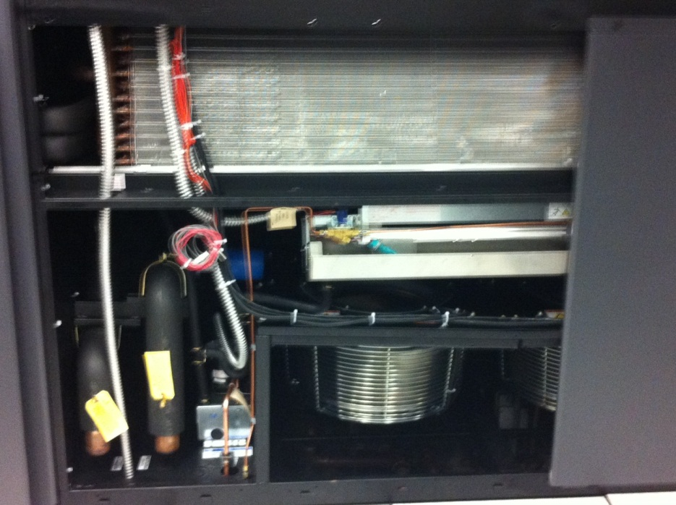
Initial Phase – Critical Cooling Issue
Data Center Stabilization
Initial Phase – Critical Cooling Issue - Completed September 27, 2012
Portable A/C unit for emergency use
Add 2 Permanent A/C units to stabilize environment
Old Unit New Unit

Slide 4
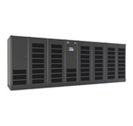
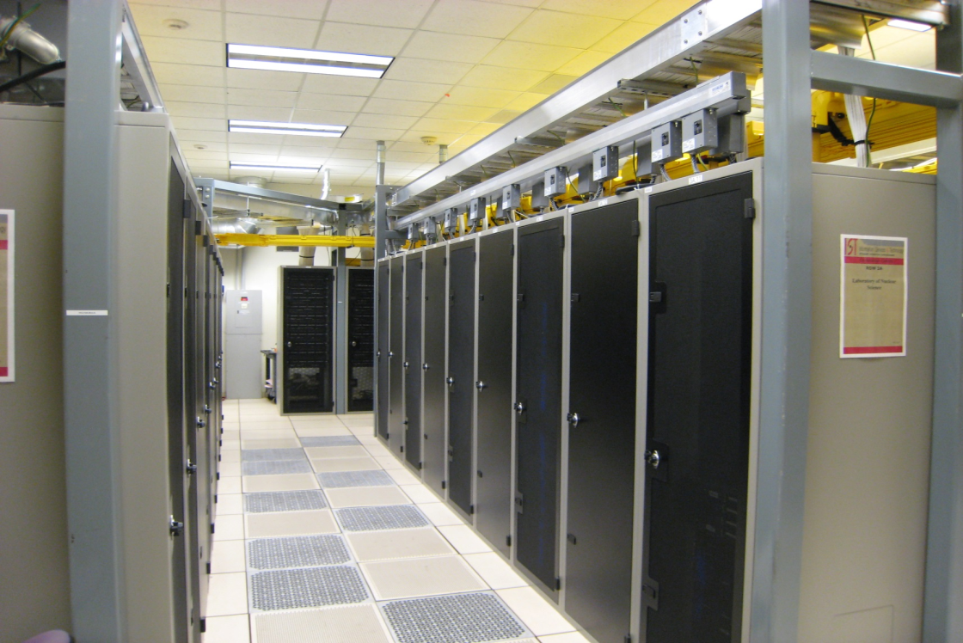
Deliverables
Data Center Stabilization
Deliverables
Redundant UPS system
Overhead cable tray for distribution – better under floor airflow
Overhead power distribution – allow UITS to provision power
Network infrastructure and distribution – to build redundant links
Complete A/C upgrade – To allow further expansion
Removal of all (6) old water based CRAC units – Allows maintenance
Move cables out of raised floor – mitigate electrical hazards
New monitored infrastructure – to keep user community informed

Slide 5
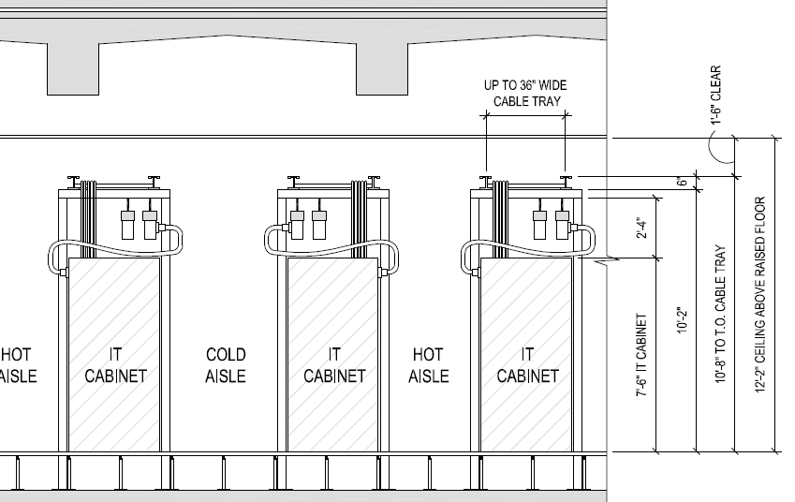
IT Cabinets in Server Room
Data Center Stabilization

Slide 6
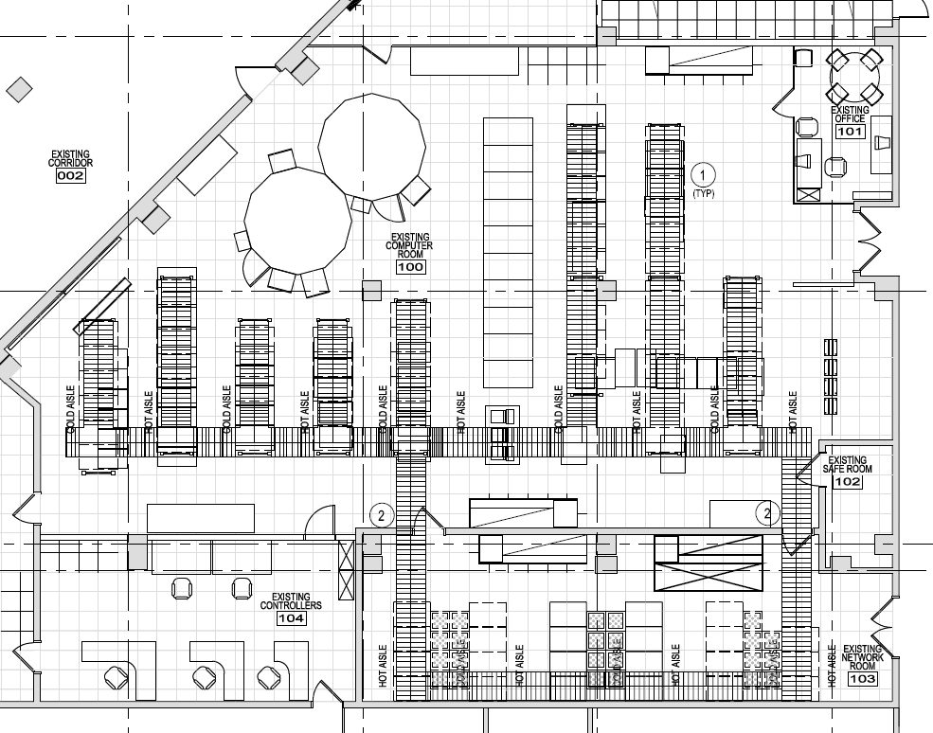
Schematic drawing of server room
Data Center Stabilization

Slide 7
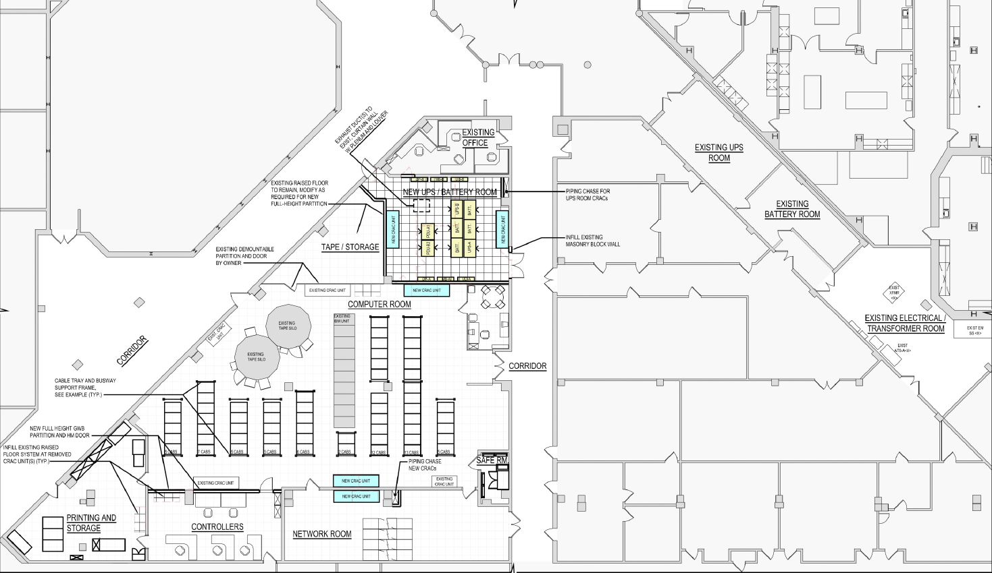
Schematic drawing of server room with other rooms surrounding it
Data Center Stabilization

Slide 8
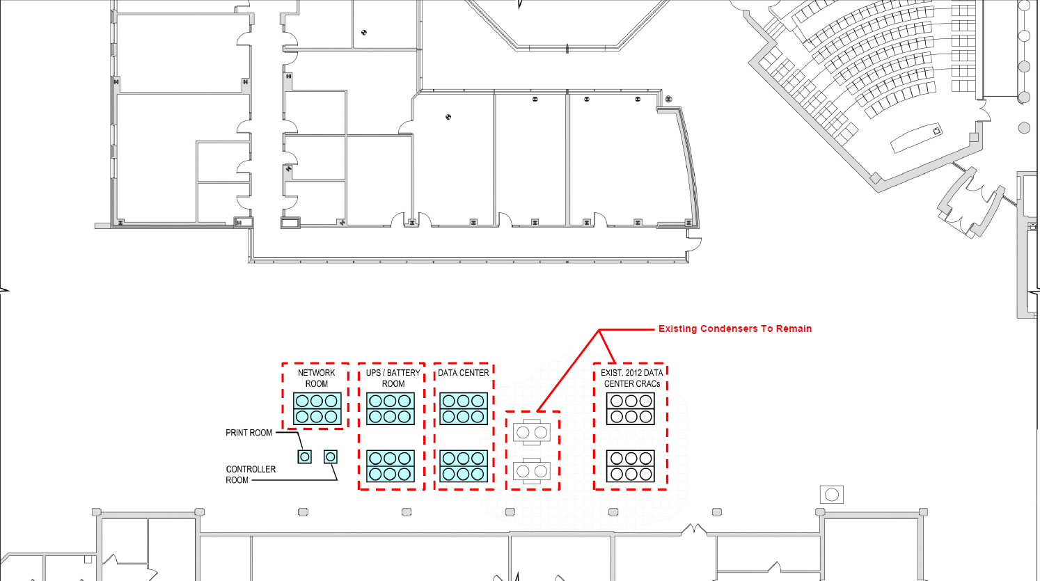
Schematic drawing of exiting condensers to remain
Data Center Stabilization

Slide 9
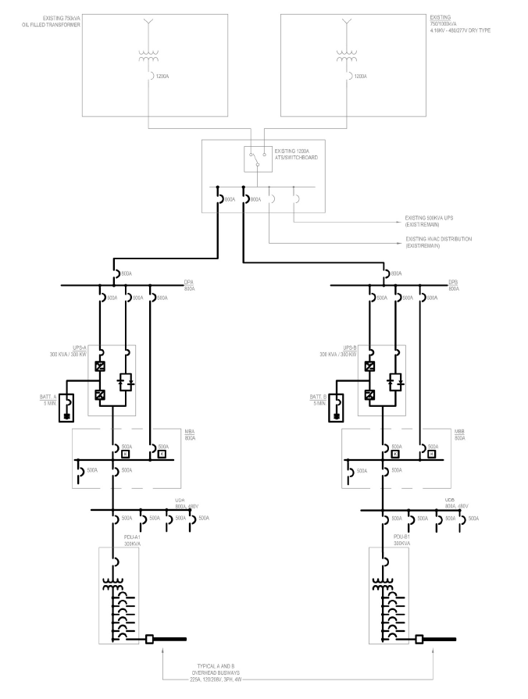
Schematic drawing of power in server room
Data Center Stabilization

Slide 10
Current Timeline
Data Center Stabilization
Current Timeline:
Issue 50% Design Package August 1,2013
Client Page turn of Package August 8, 2013
Client page turn of bid September 12,2013
Issue Bid / Permit Package Sept 25, 2013
Receive Bid October 23, 2013
BOT Approval November 13, 2013
Award Recommendation November 15, 2013
Contract Award November 27,2013
Construction Begins December 2013
Equipment on site January 2014
Completion March 2014

Slide 11
Questions?
Data Center Stabilization

