Slide 1
Two Factor Authentication
Two Factor Authentication
Josh Boggis
Community
Integrity
Contribution
Attitude

Slide 2
What is 2FA?
Adds a second layer of security to your accounts. Takes something you know (userid and password) with something you have (mobile device) to approve authentication requests.
What product are we using?
Community
Integrity
Contribution
Attitude

Slide 3
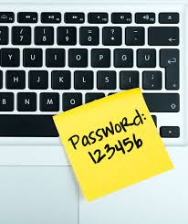
Why are we implementing this?
Compliance
PCI
HIPAA
SRI (NIST 800-171)
Community
Integrity
Contribution
Attitude

Slide 4
How will this impact me?
Community
Integrity
Contribution
Attitude

Slide 5
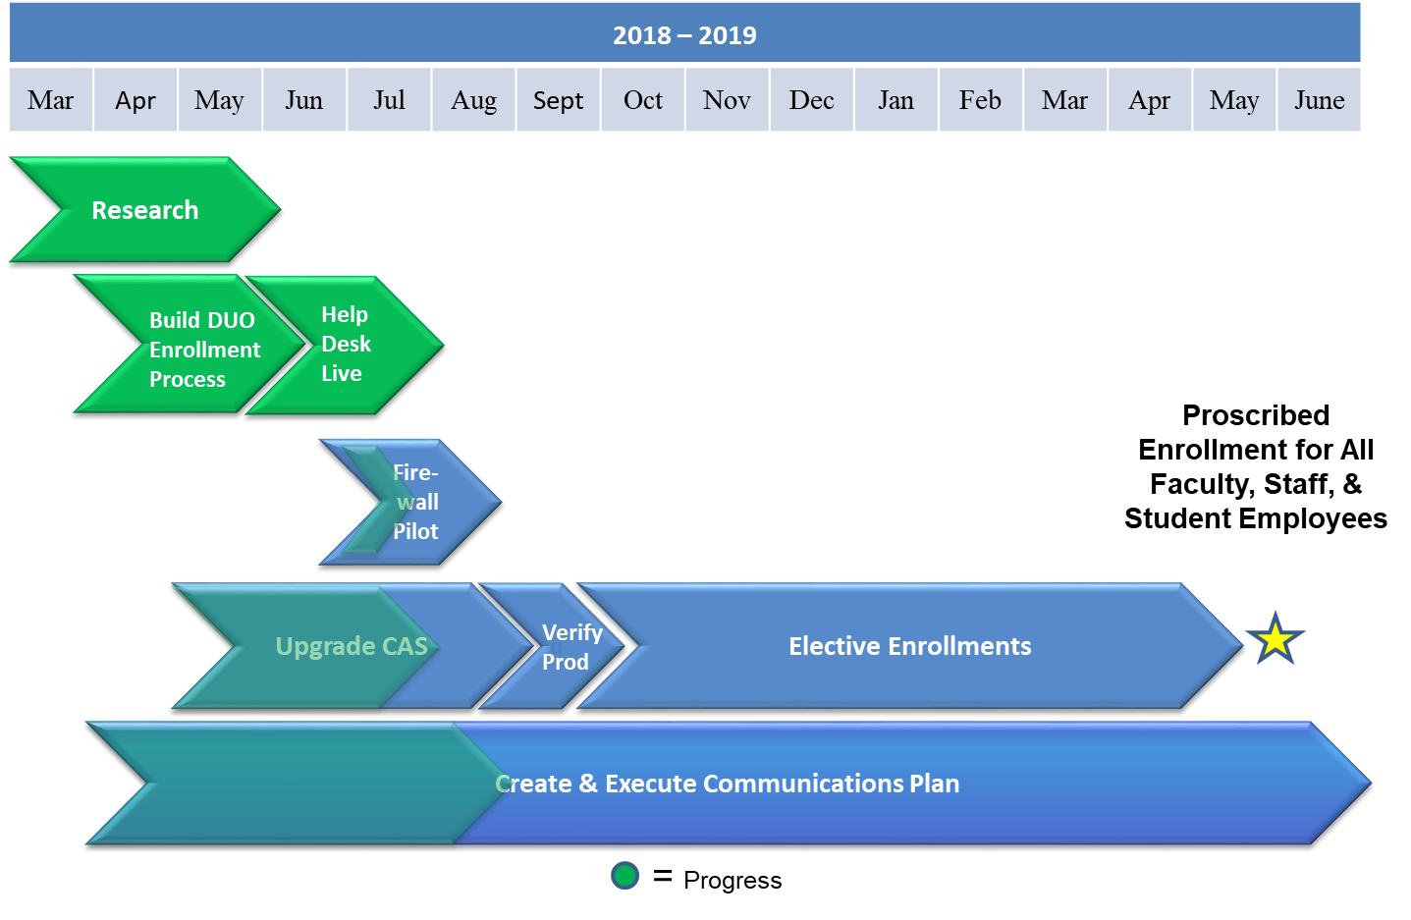
Project Timeline
Community
Integrity
Contribution
Attitude

Slide 6
Demo
Community
Integrity
Contribution
Attitude

Slide 7
Questions?
Community
Integrity
Contribution
Attitude

Slide 8
Thank You
Community
Integrity
Contribution
Attitude

