Slide 1
Classroom Technology
Haleh Ghaemolsabahi
27 July 2018

Slide 2
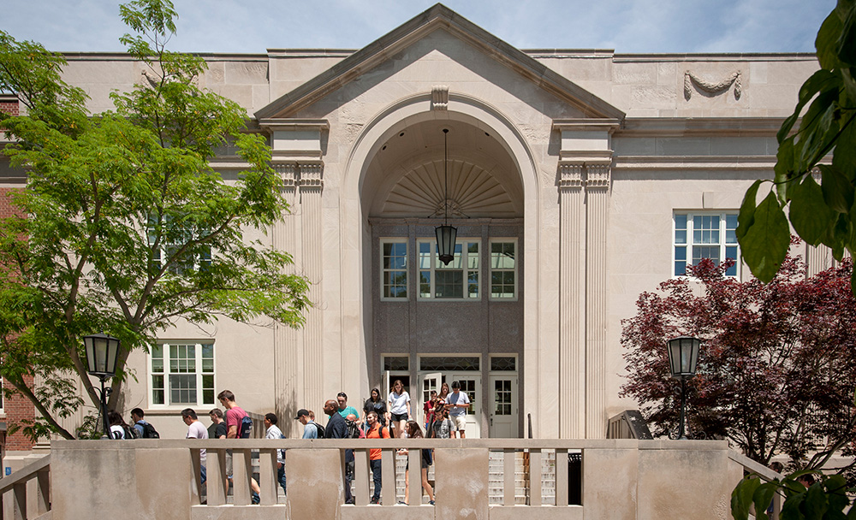
Classroom Technology
IT systems, services, and capabilities continuously evolve.
We strive to balance currency, capability, complexity, and cost.
Support for teaching and learning is a core component of our strategic plan.
ITS pursues continuous improvements to fulfill our commitment to the UConn community and institutional mission.
Community
Integrity
Contribution
Attitude
Notes:
IT systems, services, and capabilities continuously evolve, and we strive to maintain the best practical balance between currency, capability, complexity, and cost. Support for the teaching and learning endeavor is a core component of our existing strategic plan, and ITS pursues continuous improvements in fulfillment of our ongoing commitment to the university community and their institutional mission.

Slide 3
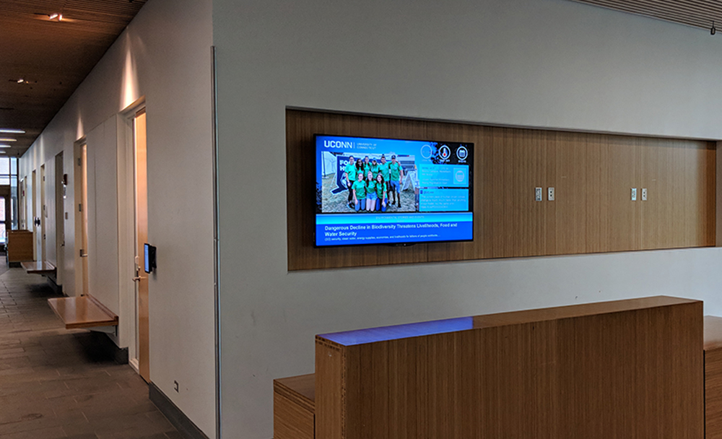
Classroom Technology
As of September 2017, no classroom technology is more than 5 year old, and all centrally scheduled classrooms are on a 5-year life cycle.
Every classroom building has a large digital sign. It displays University information. Departments within the building can display notifications.
In an emergency, all digital signs will be taken over by emergency communications.
Community
Integrity
Contribution
Attitude

Slide 4
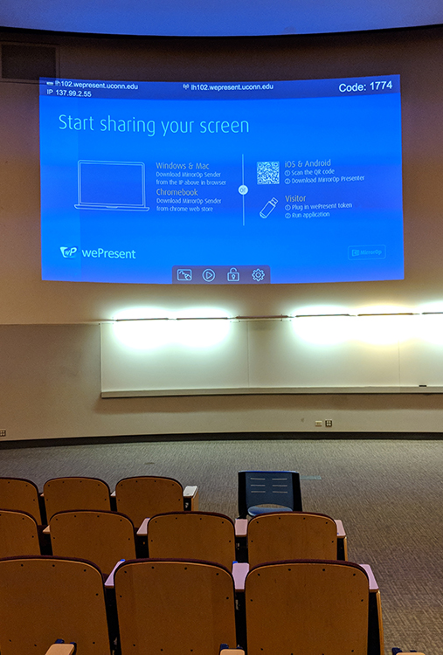
Classroom Technology
All lecture halls in Storrs are equipped with:
wePresent
EZX Self-Service Lecture Capture
Teach-from video conferencing
(Austin coming up winter break)
All regional campuses have at least one room equipped with:
EZX Self-Service Lecture Capture
wePresent
As upgraded, classrooms will get wePresent and EZX.
Community
Integrity
Contribution
Attitude

Slide 5
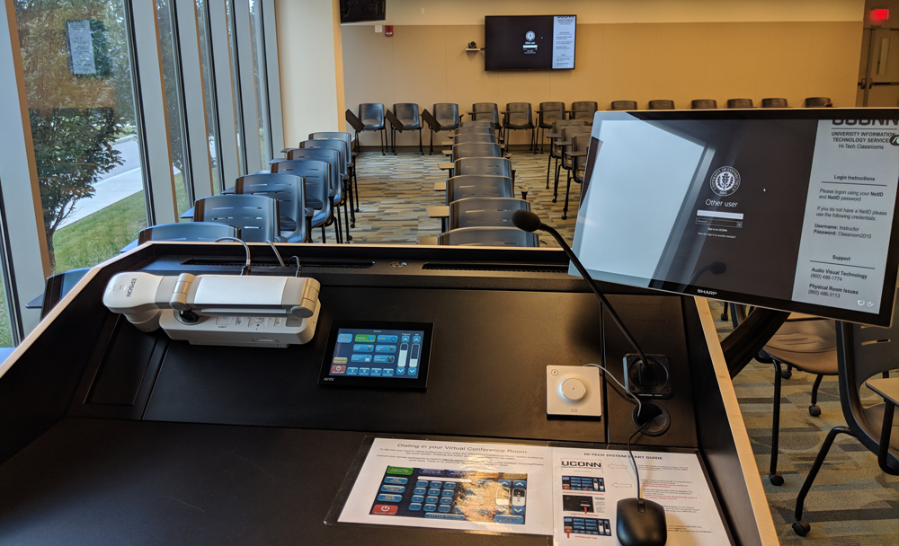
Classroom Technology
Full video conference (huge cost difference) in 10 classrooms at Storrs and at least one in every other campus
Handful of seminar rooms that are the same as other standard video-enabled conference rooms
Community
Integrity
Contribution
Attitude

Slide 6
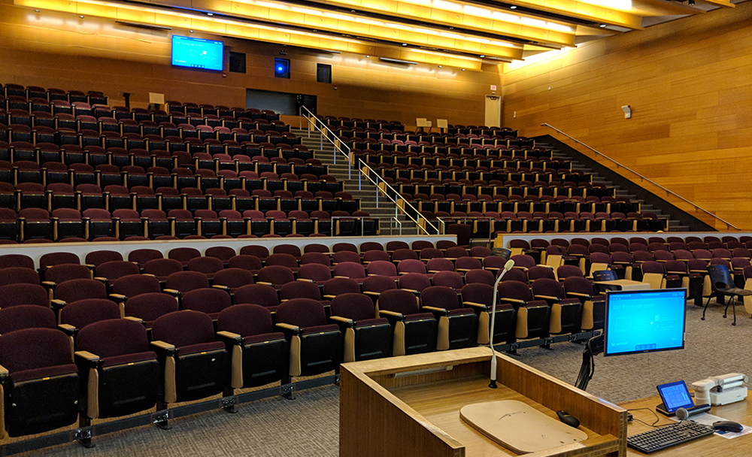
Classroom Technology
Every classroom building has a large digital sign.
Every lecture hall has a small digital sign with the classroom schedule.
As upgraded, classrooms will get digital signage to display their schedule.
In an emergency, all digital signs, small and large, will be taken over by emergency communications.
Community
Integrity
Contribution
Attitude

Slide 7
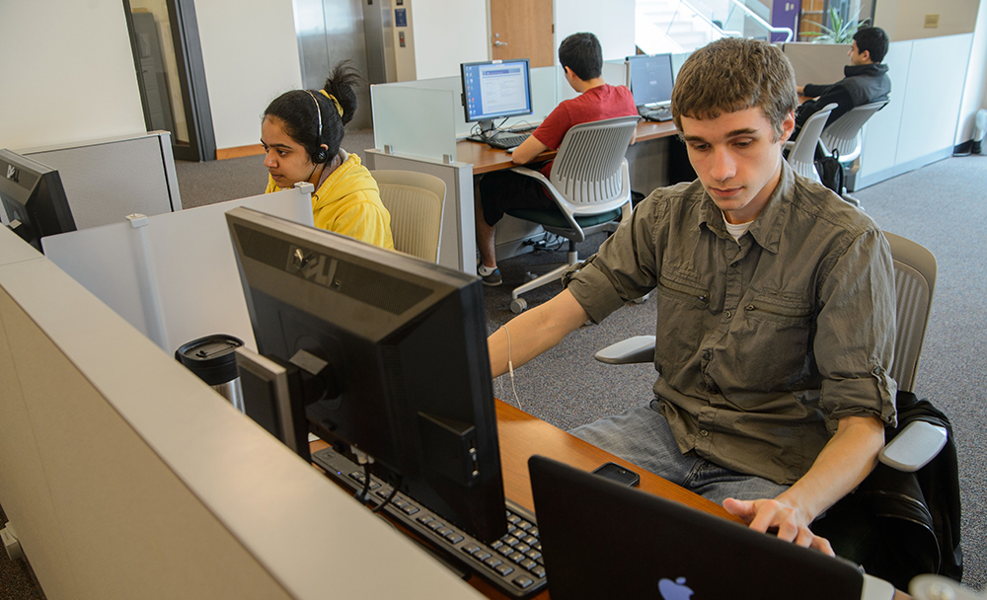
Classroom Technology
All computers on all campuses will be replaced in the classrooms, lights out management.
All classrooms in regional campuses are rolled into the managed workstation service and will be managed centrally.
Community
Integrity
Contribution
Attitude

Slide 8
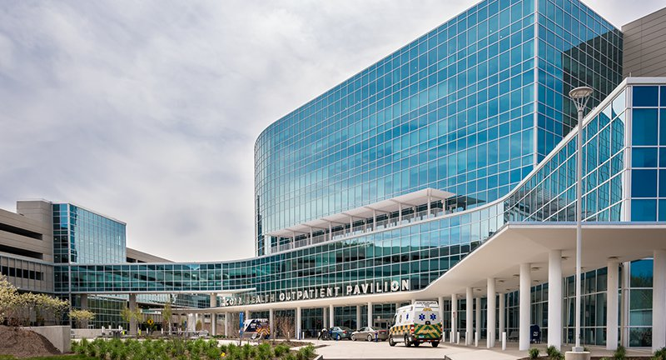
Classroom Technology
UConn Health:
We are working with UConn Health to design their classrooms based on university standards.
Community
Integrity
Contribution
Attitude

Slide 9
Classroom Technology
A UConn group visited McGill last month.
We drew excellent classroom design ideas.
Our classroom technology is at a good, solid state.
Community
Integrity
Contribution
Attitude

Slide 10
Thank You
Questions?
Community
Integrity
Contribution
Attitude

Slide 11
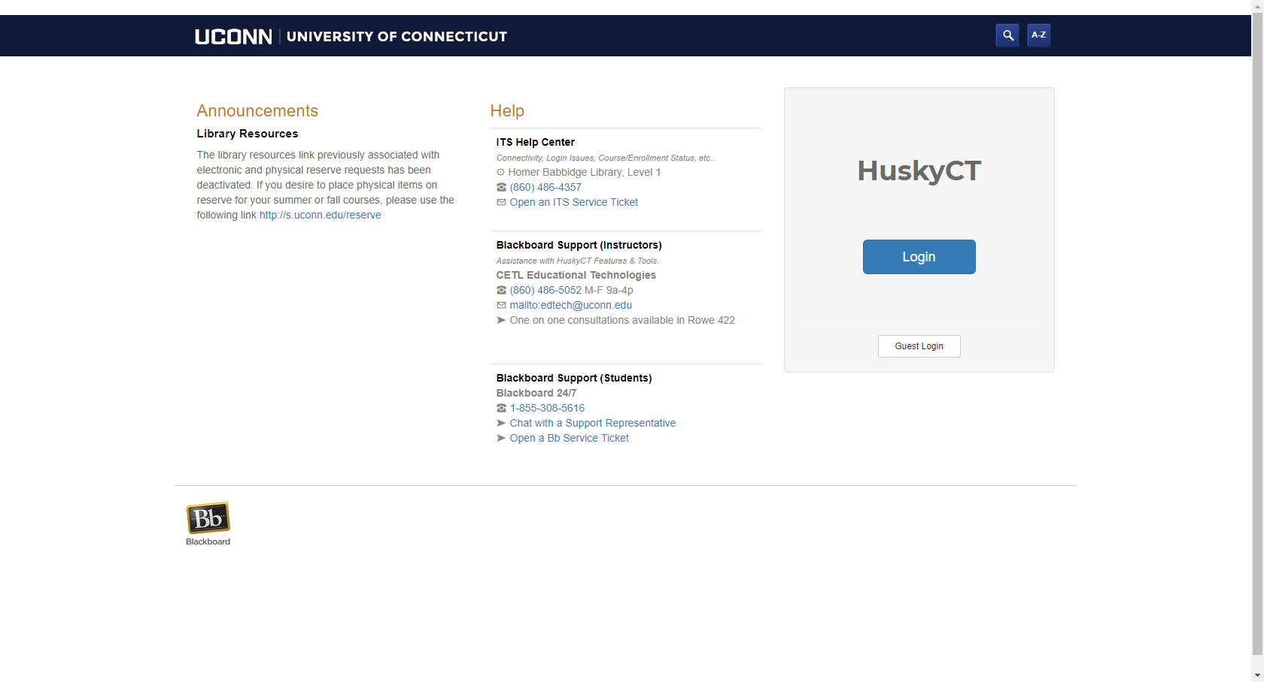
Test
lms.uconn.edu
Community
Integrity
Contribution
Attitude

