Slide 1

Aurora
UConn’s Web Content Management System
Andrew Bacon and Yi Zhang of the UITS Web Development Lab, November 2013.

Slide 2


Goals
Goals
What’s a CMS for?
It’s a way to reduce the difficulty of managing a website, while also improving the code quality of websites.
Easier to create and update websites
Build better websites. Better Search Engine ranking, accessibility, security and stability.
Notes:
Goals
What’s a CMS for?
It’s a way to reduce the difficulty of managing a website, while also improving the code quality of websites.
Easier to create and update websites
Build better websites. Better Search Engine ranking, accessibility, security and stability.

Slide 3

Constraints
UConn has a unique set of constraints
Notes:
UConn has a unique set of constraints

Slide 4
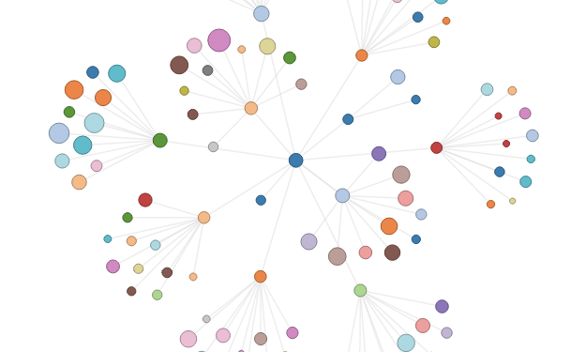

Sites and Staff
Thousands of decentralized sites
Hundreds of webmasters with varied levels of expertise
Limited UITS support & development staff
Notes:
Thousands of decentralized sites
Hundreds of webmasters with varied levels of expertise
Limited UITS support & development staff

Slide 5

Strategy
With these constraints, we came up with some strategic objectives when designing Aurora
Notes:
With these constraints, we came up with some strategic objectives when designing Aurora

Slide 6
Simple Sites
Target the majority of simple sites at UConn
Complex or unique sites may remain as they are
One size fits most, not one size fits all
All Sites
Aurora
Notes:
Target the majority of simple sites at UConn
Complex or unique sites may remain as they are
One size fits most, not one size fits all

Slide 7

Decisions
Decision to value Ease and Quality over features and flexibility
Learning curve kept as low as possible
Deliver a simple high quality service, leaving out potentially useful features to preserve simplicity
Features, Flexibility
Ease, Quality
Notes:
Decision to value Ease and Quality over features and flexibility
Learning curve kept as low as possible
Deliver a simple high quality service, leaving out potentially useful features to preserve simplicity

Slide 8

Community
From the outset, we’ve been working with the University Community to shape Aurora into the service it is today.
Notes:
From the outset, we’ve been working with the University Community to shape Aurora into the service it is today.

Slide 9
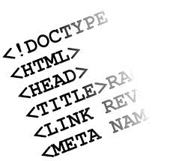
Developers Group
Email list
Monthly meetups and presentations
Polls for feedback to help set priorities
Notes:
Email list
Monthly meetups and presentations
Polls for feedback to help set priorities

Slide 10

Governance
Representatives from Schools and Colleges across campus that use Aurora, who clearly understand their unit’s web needs & priorities
Help set policies
Makes final determinations on focus and priorities of UITS resources
Notes:
Representatives from Schools and Colleges across campus that use Aurora, who clearly understand their unit’s web needs & priorities
Help set policies
Makes final determinations on focus and priorities of UITS resources

Slide 11

Custom Code
Custom theme and plugin is possible (Dev/Test/Prod environments)
Sandbox Agreement (long term commitment)
Notes:
Custom theme and plugin is possible (Dev/Test/Prod environments)
Sandbox Agreement (long term commitment)

Slide 12

Code Audit
Reviews all Custom Code, and any new Plugins
Web Lab, Security Office, and volunteers from Distributed IT
Meet regularly to set coding standards and review new work
Notes:
Reviews all Custom Code, and any new Plugins
Web Lab, Security Office, and volunteers from Distributed IT
Meet regularly to set coding standards and review new work

Slide 13

Aurora Today

Slide 14



Timeline of Events
Launched with UConn’s first Modern Mobile Responsive Template
Since the Launch we’ve augmented Wordpress with a lot of great features
New Homage widgets like Events Calendar, Contact, Hours of Operation, and Rich Text Widget.
Plugins to check for broken links, smooth out the launch process, track statistics, and swap out media files.
Last month we released the Gravity Forms Builder, a cool new way to create online forms.
Notes:
Launched with UConn’s first Modern Mobile Responsive Template
Since the Launch we’ve augmented Wordpress with a lot of great features
New Homage widgets like Events Calendar, Contact, Hours of Operation, and Rich Text Widget.
Plugins to check for broken links, smooth out the launch process, track statistics, and swap out media files.
Last month we released the Gravity Forms Builder, a cool new way to create online forms.

Slide 15

Training
30+ hours of training
16 sessions
268 users trained
Notes:
30+ hours of training
16 sessions
268 users trained

Slide 16

@ 4 months
38 live websites
350+ accounts
450+ webmasters
109,000 unique visitors
Notes:
38 live websites
364 websites in development
458 webmasters
109,000 unique visitors
What’s Next?

Slide 17
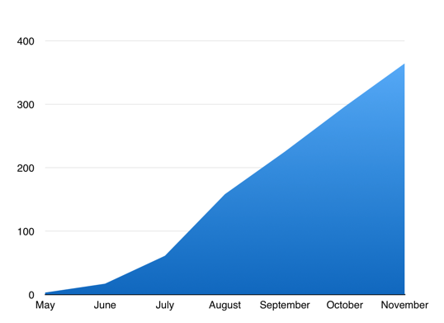
Graph of Demand
Just to give you an idea of the demand out there, and the growth rates we’re seeing,
Here’s the Number of Total Accounts
Beta
Launch
Notes:
Just to give you an idea of the demand out there, and the growth rates we’re seeing,
Here’s the Number of Total Accounts

Slide 18
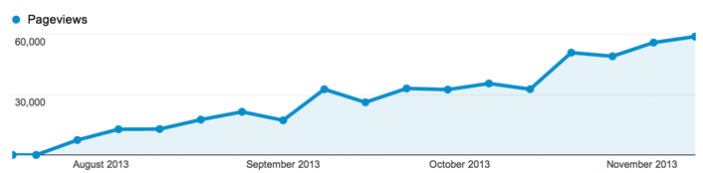
Page Views per Week
Here’s Page views per week, this shows us how many users are visiting the pages, up to about 60k now.
Notes:
Here’s Page views per week, this shows us how many users are visiting the pages, up to about 60k now.

Slide 19
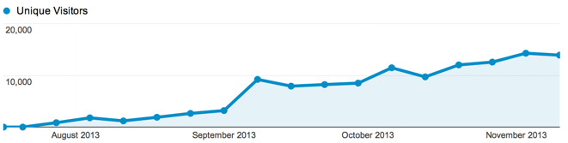
Unique Visitors per Week
Unique Visitors per week
Notes:
Unique Visitors per week

Slide 20
Future of Aurora
Future of Aurora
Take the limited service, and carefully add new features, to accommodate a greater number of sites.
Ongoing outreach & training
Upcoming changes under consideration
  Wordpress 3.7 and better media library management,
  new navigation styles and page layouts
  secure intranet,
  improved user management
  multiple sidebars per site
Notes:
Future of Aurora
Take the limited service, and carefully add new features, to accommodate a greater number of sites.
Upcoming changes under consideration
Wordpress 3.7,
better media library management,
new navigation styles,
page layouts,
secure intranet,
improved user management
multiple sidebars per site
Ongoing outreach & training

Slide 21
Learn more
Slides and more:
aurora.uconn.edu
@uconnwebdev
If you’re interested in learning more about Aurora, signing up for an account, or scheduling training, you can head to the address here.
If you’re on twitter you can follow us @uconnwebdev for news about updates, community polls, and Q&A sessions we hold monthly.
Notes:
If you’re interested in learning more about Aurora, signing up for an account, or scheduling training, you can head to the address here.
If you’re on twitter you can follow us @uconnwebdev for news about updates, community polls, and Q&A sessions we hold monthly.

