Slide 1
Improving Service Delivery with IT Automation
IT All Staff Conference
October 4, 2022
Abiodun Obajinmi
Enterprise Systems

Slide 2
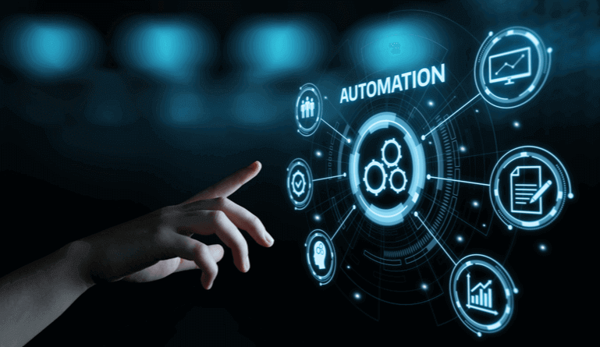
What is IT Automation?
IT automation is a set of instructions that are used to define the method of executing repeated processes that eliminates any sort of manual work erstwhile performed by IT professionals.

Slide 3
How does IT Automation work?
It uses software tools, frameworks, and other machines to execute tasks that are repetitive in nature.

Slide 4
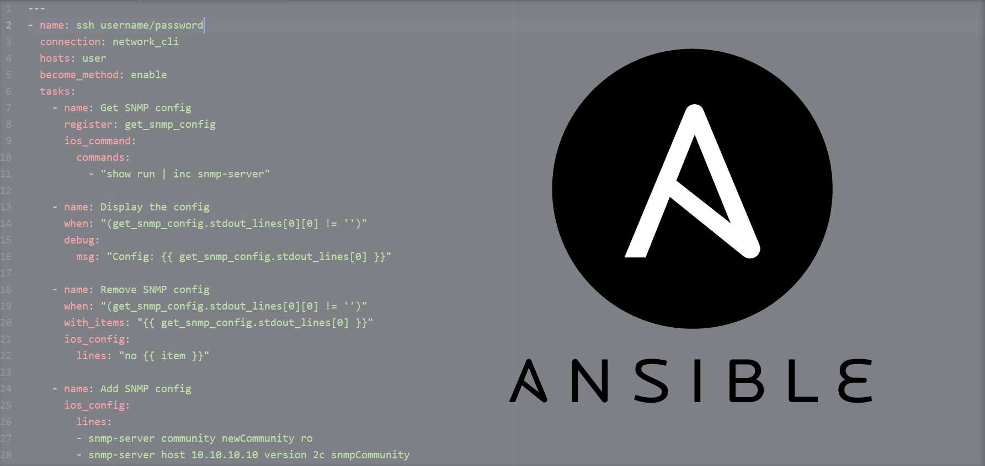
Some Benefits of IT Automation
Efficiency
Accuracy
Consistency
Scalability

Slide 5
Ansible as an IT Automation Tool
Ansible is an open-source IT automation tool that provides simple but powerful automation for cross-platform IT tasks.
Ansible is:
Written in simple, human-readable
format code
Agentless (you don't have to install ansible on the target node)
Idempotent (An operation is idempotent if the result of performing it once is the same as the result of performing it repeatedly without any intervening actions)

Slide 6
Ansible Automation Platform
Ansible Automation Platform provides an enterprise framework for building and operating IT automation at scale, from hybrid cloud to the edge.

Slide 7
People-Centric Linux Virtual Machine Deployment
Average Deployment Time = 120 mins
Jira Ticket for VM request
Create VM and add resources
Provision and Configure VM
Test Functionality and deploy VM
Customer gets notified and receives VM
Customer
Virtualization Team
Server Systems Team

Slide 8
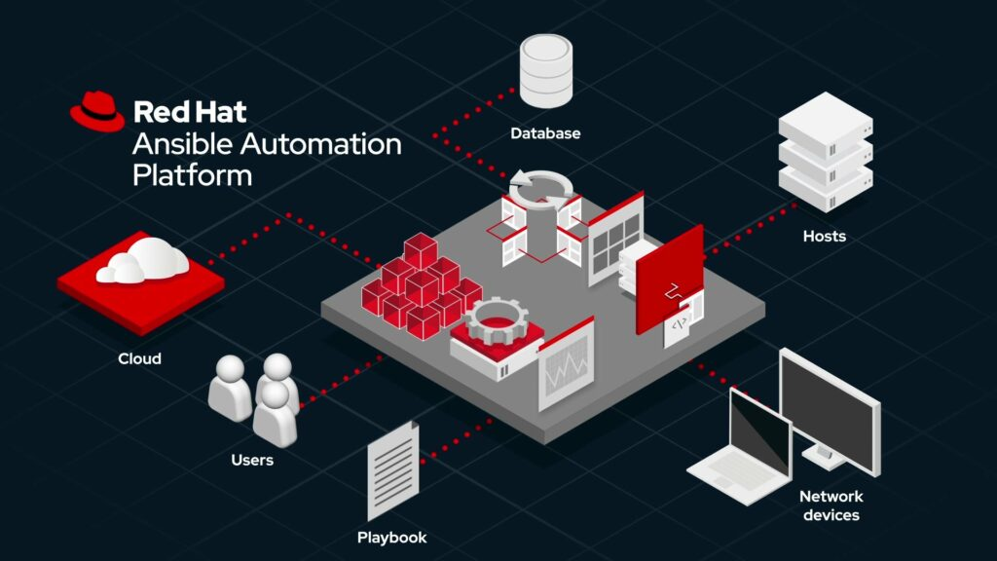
Tool-Centric Linux Virtual Machine Deployment
Average Deployment Time = 25 mins
Jira Ticket for VM request
Create VM and add resources
Provision and Configure VM
Test Functionality and deploy VM
Customer gets notified and receives VM
Ansible Playbooks
Customer
Version Control

Slide 9
Key Takeaways
Identify processes where automation can be applied
Automation is not a key for broken processes
Though tasks can be automated, sometimes you still require human judgement

Slide 10
Thank You
Questions?

Slide 11
Copyright
Copyright © University of Connecticut Information Technology Services 2018. This work is the intellectual property of the author. Permission is granted for this material to be shared for non-commercial, educational purposes provided that this copyright statement appears on the reproduced materials and notice is given that the copying is by permission of the author. To disseminate otherwise or to republish requires written permission from the author.

