Slide 1
Budget, Planning and Institutional Research Power BI Demonstration
Dan Sokol & Joe Daniels
October 4, 2022

Slide 2
Data Provided by BPIR
BPIR provides data for internal decision making and external mandated reporting

Slide 3
Previous Reporting Tools
Prior tools insufficient for end-user needs
Static PDF/Excel Tables
Not user-friendly: no filtering or drilldown capability
Manually produced, time consuming
Multiple reports for request variations
SAS Visual Analytics
Annual license fee
Report development difficult
Report navigation difficult for users
Required BPIR to manually upgrade software
Tableau
Secure server version not free
Public version can’t satisfy internal reporting requirements

Slide 4
Why BPIR Uses Power BI
Power BI offers more for developers and users
The benefits of Power BI:
Microsoft product, integrates with current UConn software
Teams, PowerPoint, Excel, and SharePoint
Included in Office 365 - Free for UConn staff
Report development is easy and intuitive
Easy to replicate tabs and customize reports
Extremely user-friendly to navigate
Users can make custom views
Easily embedded into webpages
Future integration with SAS datasets

Slide 5
Access to Power BI Dashboards
BPIR controls access and maintains privacy
UConn “Internal” log-in required Dashboards
Ongoing consultation with University Privacy Officer
Users request access and indicate business need
BPIR grants access
Three levels of users:
High level trend overview
Targeted information retrieval
Export for deeper analysis
Pilot “public” Student Enrollment Dashboard developed for Fall 2022
De-identified, FERPA compliant data
Public currently uses PDF reports on website

Slide 6
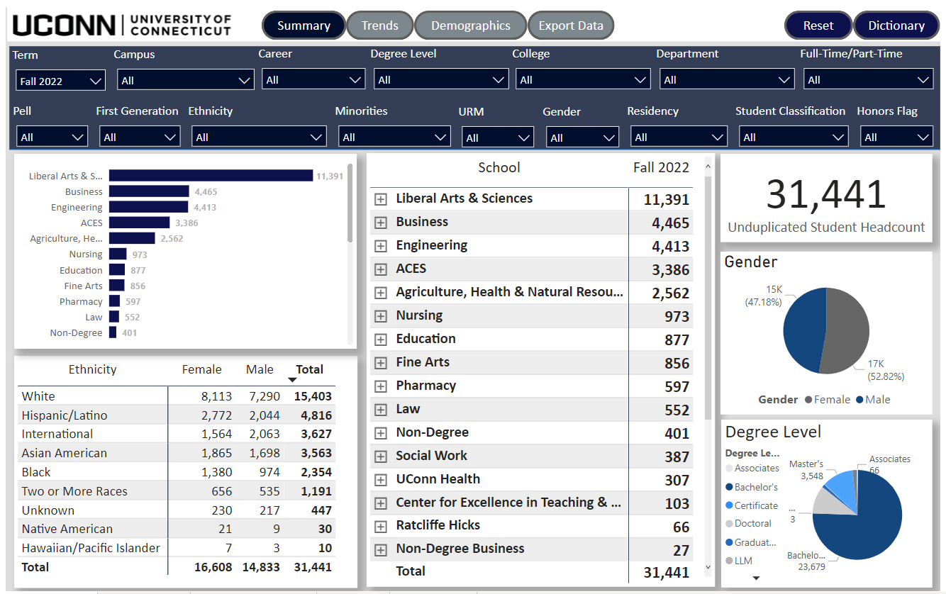
Demonstration of Power BI Dashboards
Website Version of Student Enrollment
Dashboards Login Required
Power BI Home

Slide 7
Public Student Enrollment Dashboard
Dashboards Public

Slide 8
Public Training Dashboard

Slide 9
Contacts
Budget, Planning and Institutional Research
https://bpir.uconn.edu/
Daniel Sokol – Data Warehouse Administrator Team Lead
daniel.sokol@uconn.edu
Joseph Daniels - Data Warehouse Developer and Analyst II
joseph.daniels@uconn.edu
Sam Post - Data Warehouse Developer and Analyst
samuel.post@uconn.edu
Vitaly Glybin - Operating Systems and Applications Administrator
vitaly.glybin@uconn.edu

