Slide 1
Classroom Technology as a Capital Planning Exercise
IT All Staff Conference
M. Mundrane
August 10, 2022

Slide 2
UConn
Public research university
Land grant institution
Research
Teaching
Learning
Outreach
340 supported locations
Two out of four primary missions are classroom related

Slide 3
History
Misaligned priorities
Departments work at cross purposes
Disparate activities
Minimal coordination for effect
Sporadic funding
Ad-hoc and found money
Short lead time
End of year procurement

Slide 4
Outcomes
Confused mission
Staff are de-facto builders
Scaling problems
Inability to meet obligations
Cannibalized support
Day to day experience suffers
Uneven results
Widely varying type and age
Inconsistent experience
Cannot translate between locations

Slide 5
Leasing
Cash flow tool
Same financial constraints and challenges
Does not clarify the problem
Adds the cost of money
This is a red herring!

Slide 6
Yogurt Inventory
Weekly behavior…
Acquire 8 yogurts
Consume 7 yogurts

Slide 7
Yogurt Inventory
Weekly behavior…
Acquire 8 yogurts
Consume 7 yogurts
???

Slide 8
Approach
Understanding.
Financially driven
Realities
Expenses not all equal
Commitment
Persistent results
Priorities
Outcomes not classrooms

Slide 9
Operating Expense
Single year
Fiscal budget driven
Staffing
Design, oversight, and support
Licensing
Ongoing and escalating
Supplies
Predictable in the aggregate
Break fix

Slide 10
Capital Expense
Multi year
Life cycle driven
Evolution
Long term change
Equipment
Hardware centric
Cost to deploy
labor

Slide 11
Life Cycle Expense
Financial Definitions
Life Cycle
$$T=total asset cost$$
$$n=lifespan in years$$
$$V=current valuation$$
$$D=depreciation$$

Slide 12
Life Cycle Expense
Financial Definitions
Life Cycle
$$T=D+V$$
$$D_{k}=\frac{T}{n}$$
Independent of year
$$V_{k}=T⋅\frac{\left(1+n\right)}{2n}$$

Slide 13
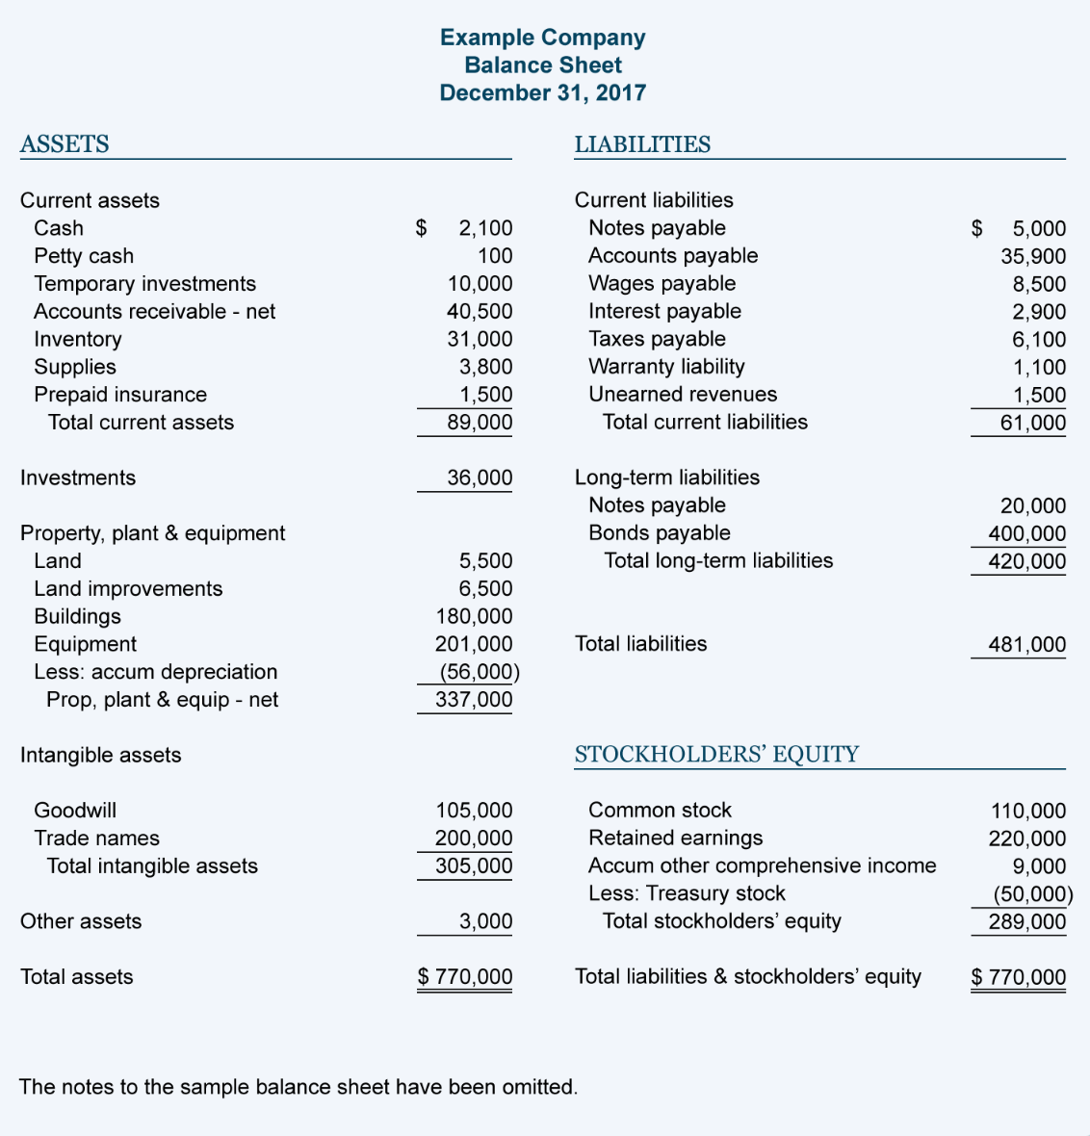
Our Numbers
13M deployed capital asset
10M equipment
3M labor
5-year life cycle
2.0M in year depreciation
2.0M per year in hardware
0.6M per year in labor
6.0M hardware residual

Slide 14
Our Numbers
13M deployed capital asset
10M equipment
3M labor
5-year life cycle
2.0M in year depreciation
2.0M per year in hardware
0.6M per year in labor
6.0M hardware residual
Big picture

Slide 15
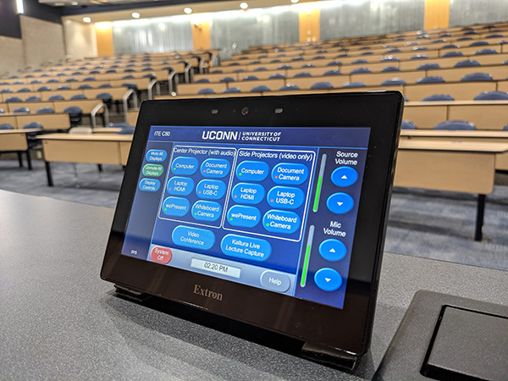
Results
High quality
Predictable
Evolving
Informed
Coordinated
Value driven

Slide 16
Results
High quality
Predictable
Evolving
Informed
Coordinated
Value driven
These are not contradictory outcomes.

Slide 17
Results
High quality
Predictable
Evolving
Informed
Coordinated
Value driven
These are certainly related.

Slide 18
Results
High quality
Predictable
Evolving
Informed
Coordinated
Value driven
… and so are these.

Slide 19
Results
High quality
Predictable
Evolving
Informed
Coordinated
Value driven
Realized Benefits
Value =
Total Actual Costs

Slide 20
Path Dependent
Best outcomes can only be attained if we fully support our classrooms...

Slide 21
Path Dependent
Classrooms can only be supported if they are properly resourced...

Slide 22
Path Dependent
Classrooms can only be resourced if they are accurately modelled...

Slide 23
Path Dependent
Classrooms can only be modeled if they are well understood...

Slide 24
Path Dependent
Classrooms can only be understood if we are willing to analyze them...

Slide 25
Conclusion
Good Analysis
Good Outcomes

Slide 26
Thank You
Questions?

Slide 27
Copyright
Copyright © University of Connecticut Information Technology Services 2022. This work is the intellectual property of the author. Permission is granted for this material to be shared for non-commercial, educational purposes provided that this copyright statement appears on the reproduced materials and notice is given that the copying is by permission of the author. To disseminate otherwise or to republish requires written permission from the author.

