Slide 1
Architecture for Data as a Strategic Asset
M. Mundrane
4/9/2019

Slide 2
Three Key Views
Systems
People
Data

Slide 3
PeopleSoft
PeopleSoft
Server
Database
Storage
LDAP
AD
DNS
DHCP
NTP
Control-M
This is a system focused view!

Slide 4
Roles
Proprietor
Steward
Custodian
Consumer
This is a people focused view!

Slide 5
Proprietor
Proprietor
Owner of the data. Is formally responsible for the data and all procedures and processes pertaining to its management and use at an institutional level.
Steward
Custodian
Consumer
People

Slide 6
Steward
Proprietor
Steward
Keeper of the data. Is formally responsible for the meaning and validity of the data both by itself and in concert with other data at the institution.
Custodian
Consumer
People

Slide 7
Custodian
Proprietor
Steward
Custodian
Holder of the data. Is formally responsible for preservation and safekeeping of the both the data and its supporting infrastructure.
Consumer
People

Slide 8
Consumer
Proprietor
Steward
Custodian
Consumer
User of the data. Is formally responsible to work with and safeguard their individual access to and use of institutional data in compliance with university policy and practice.
People

Slide 9
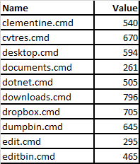
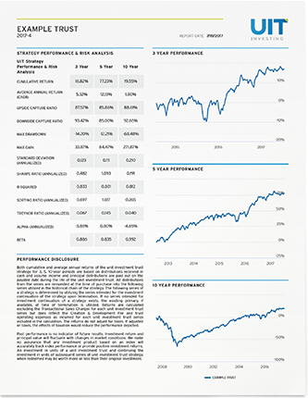
Data
Transactional system
Internal Data
Intra-system activity
Operation
This is a data focused view!

Slide 10
Integration
Second transactional system.
Inter-system activity
Integration
ETL
ETL is inherently wasteful!
Data

Slide 11
Integration
Transaction
EL
original
ETL
Broker
extended
EL
Transaction
All effort preserved!
Data

Slide 12
Reporting as Integration
Transaction
ETL
Analytic
Reporting
Other integrations are no different!
Data

Slide 13
Data Layers
Transaction
EL
EL
Managing
ETL
Broker
original
extended
EL
Analytic
Reporting
Reporting
Data

Slide 14
Thank You
Questions?

Slide 15
Copyright
© 2019 University of Connecticut Information Technology Services. This work is the intellectual property of the author. Permission is granted for this material to be shared for non-commercial, educational purposes provided that this copyright statement appears on the reproduced materials and notice is given that the copying is by permission of the author. To disseminate otherwise or to republish requires written permission from the author.

