Slide 1

Connect. Create. Collaborate.

Slide 2
The Google Support Group
Members
  Josh Boggis - UITS Unified Communications
  Angelo Fazzina - UITS Unified Communications
  Mindy Carpenter - UITS Communications
  Chris Cerrigione - UITS Communications
  Jon Moore - HuskyTech
  Adam Nemeroff - CETL eCampus
Focus - Google Roll Out 2.0
  Marketing - New Website
  New Services - Public Services
  New Audiences - Faculty/Staff

Slide 3
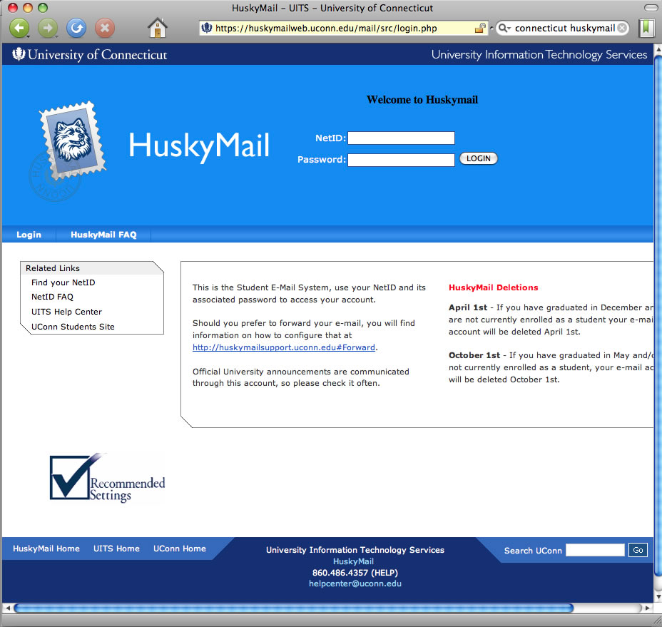

History - HuskyMail
Student Email
50 mb of storage
Aging Infrastructure
RFP for New
System - Google won the bid

Slide 4







Focus (2011) - Student Email
Core Services
Replace HuskyMail (Quick Win)
Release to just students - software as service
Core services
Google Hangout
Google Sites
Gmail
Google Calendar
Google Drive
Google Groups

Slide 5


Focus (2013) - New Direction
Goal #1 - Expand Audience and Reach
Students
Faculty
Staff
Goal #2 - Expand Services
Public Services
Goal #3 - User Education and Training
Supporting. Teaching. Learning.
Connect. Create. Collaborate.

Slide 6
Focus (2013) - Expanding Services
Core Services
Public Services
Google Hangout
Google+
Google Maps
Google Sites
Picasa Web Albums
YouTube
Gmail
Google Analytics
Chrome Web Store
Google Calendar
Google Takeout
Google News
Google Drive
Google Chrome Sync
Google Places
Blogger
Google Moderator
Google Groups
Faculty
Faculty
Opt - In
Opt - In
Staff
Staff
Students

Slide 7
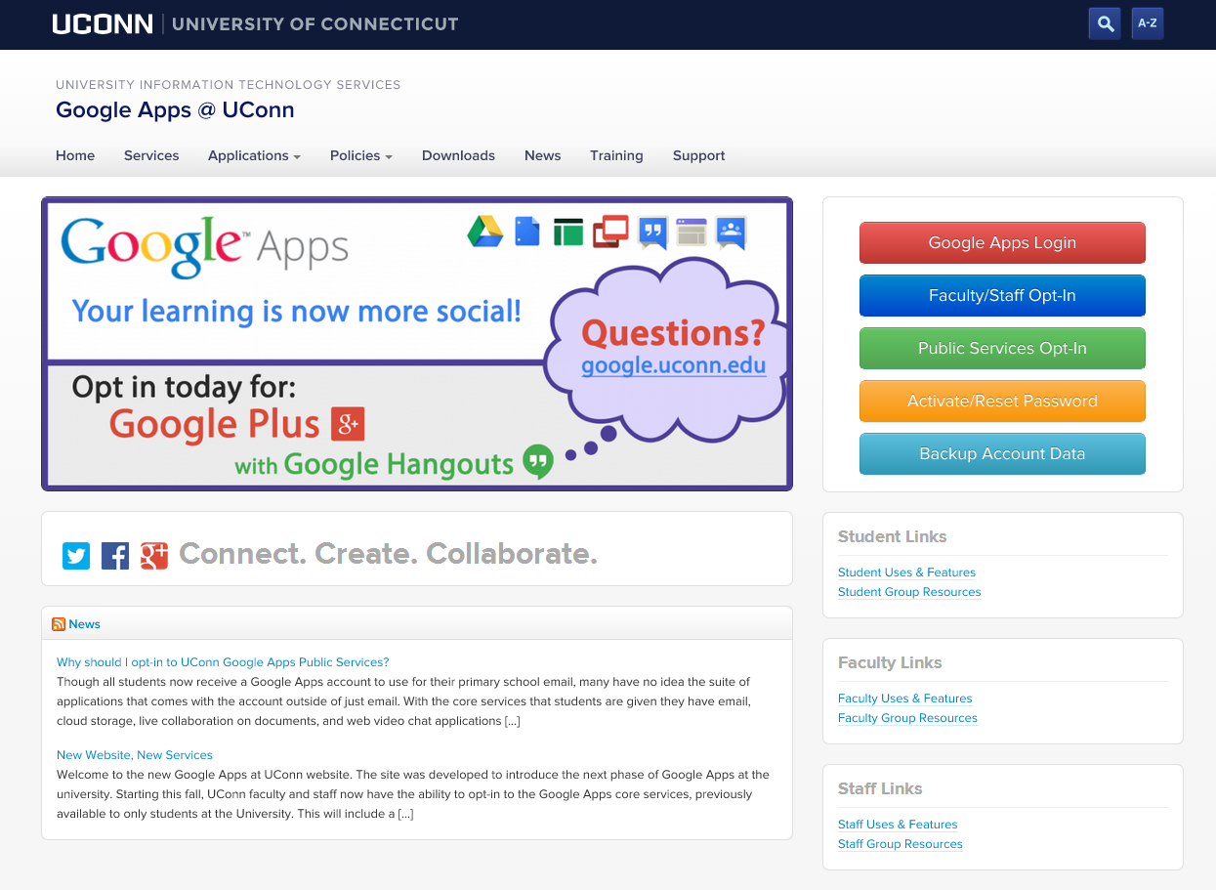
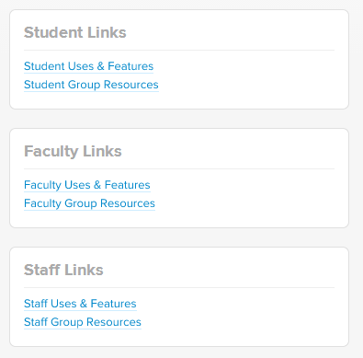
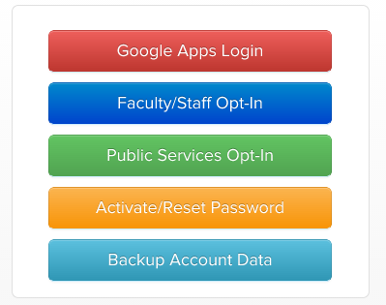
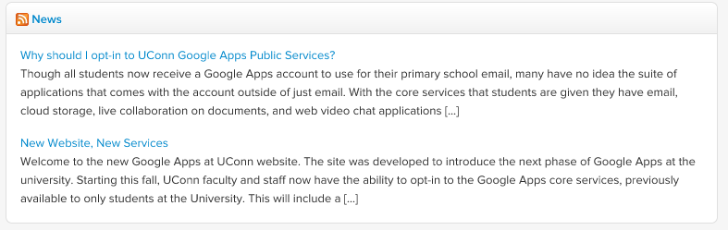

New Website. New Services.
www.google.uconn.edu

Slide 8


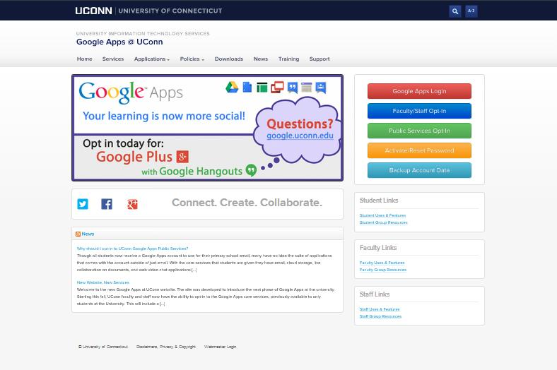



Marketing and Outreach Strategy
Group Outreach
Certification
Outbound
Initial Success
Inbound
Tabling
Website
Marketing Strategy
Digital Screens
Social Media Presence
Give-Aways
Banners
Fairs
Posters
in focus
Brochures

Slide 9
Google Across the University
Staff
Faculty
Students
Help users identify their needs.
Create innovative solutions.
Supporting. Teaching. Learning.
Connect. Create. Collaborate.
in focus
Notes:
Where we fell short the first time was education and training. Now with the additional audiences, we can look at more extensive opportunities with this.
We focus on helping each group in the unique ways and attention they need. We start with the need and we systematically create innovative solutions.
We look to help them with their activitives around Supporting ,Teaching, and Learning
We do all of this through focusing on our core mission of aiding people to create, connect, and collaborate.

Slide 10
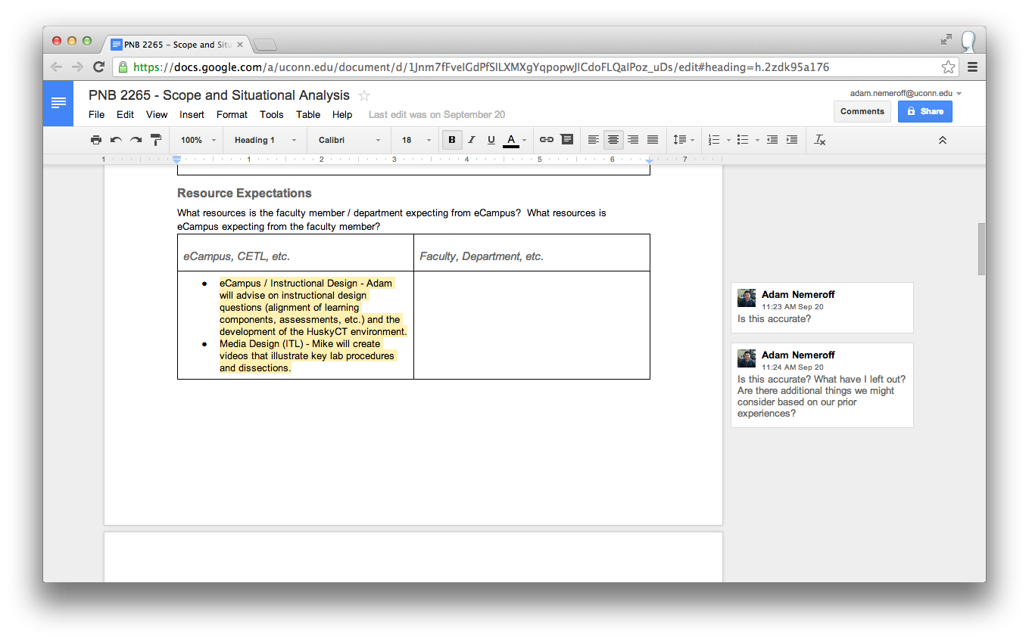
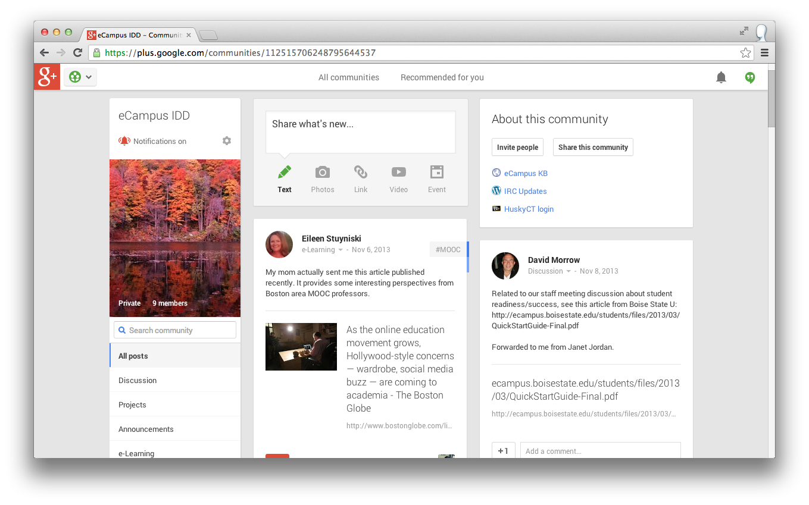


Staff - eCampus
in focus
Staff: collaborate and comment on documents and ideas (online + offline).
Staff: share ideas, news, and practices in the field of e-learning.
Documents (Google Drive)
Communities (Google+)
Notes:
My department, supports the design and development of online course at the University.
We were looking for a way to collaborate and comment on ideas and documents. We used Google Drive documents to achieve this.
We were also looking for a way to share ideas, news, and practices happening in the field of e-learning and higher ed. We created a Google+ community.

Slide 11
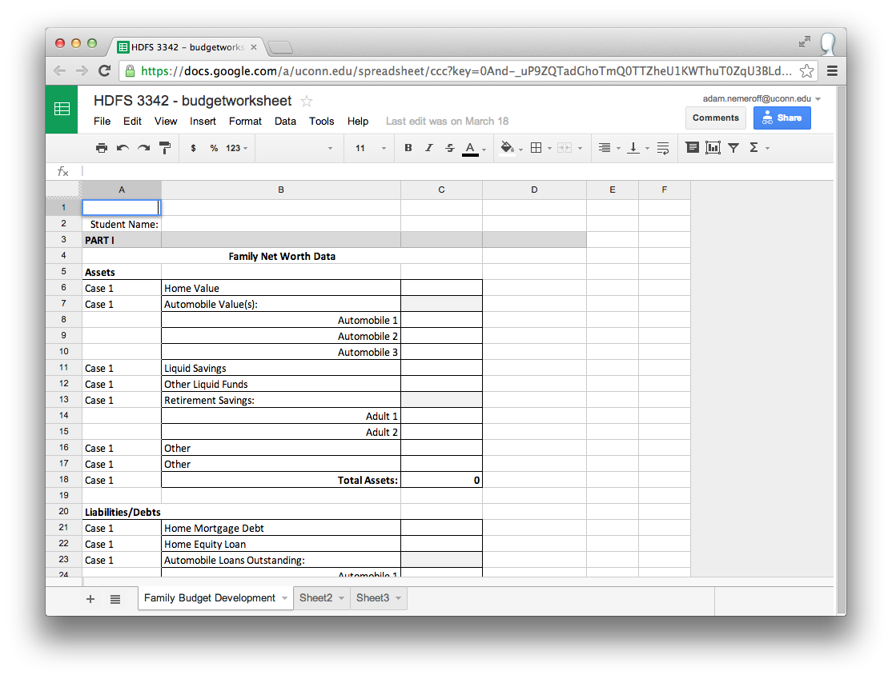
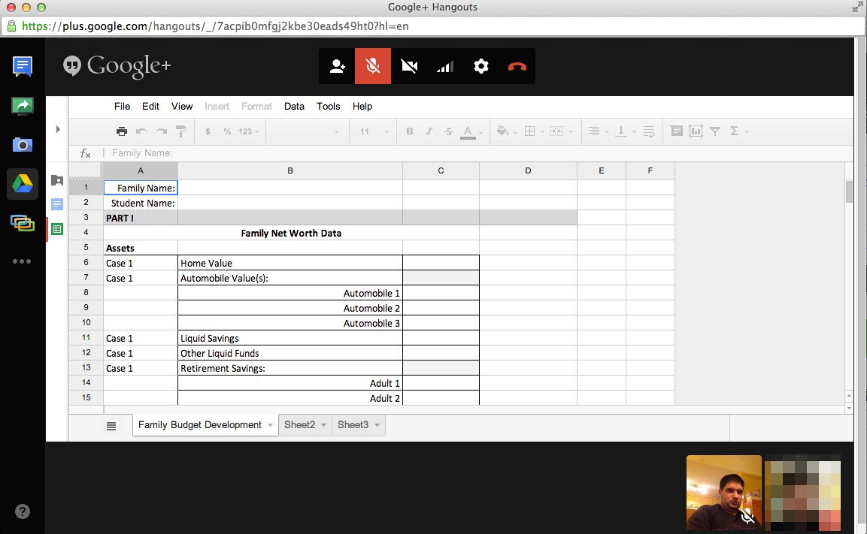


Faculty - Budgeting Assignment
in focus
Students: apply budgeting concepts and create tools to track them (import .xlsx).
Faculty: provide process feedback synchronously.
Spreadsheet (Google Drive)
Hangouts (Google+)
Notes:
A Human Development and Family Studies faculty member teaches a course on Family Resource Management.

Slide 12
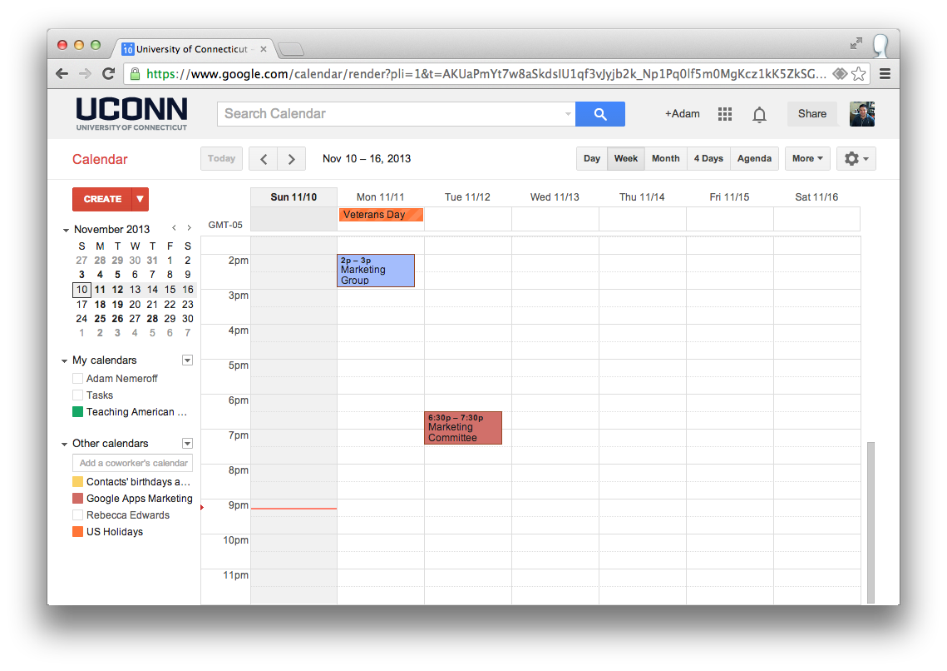
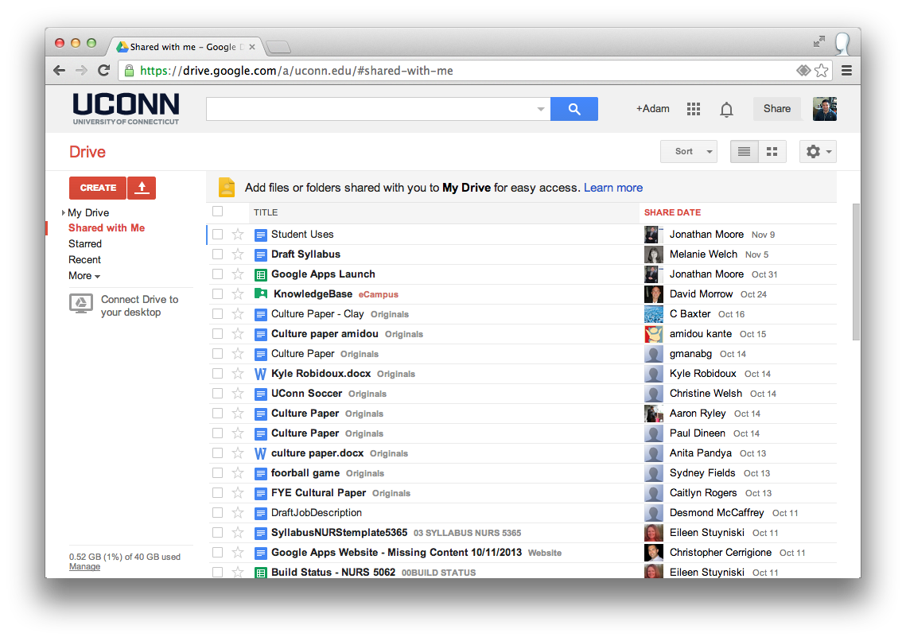
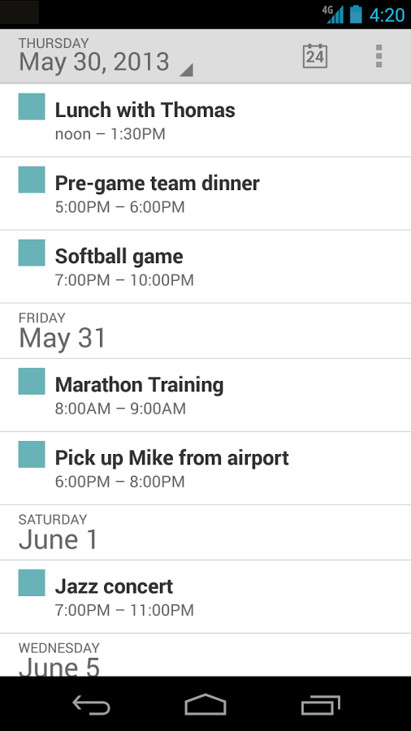
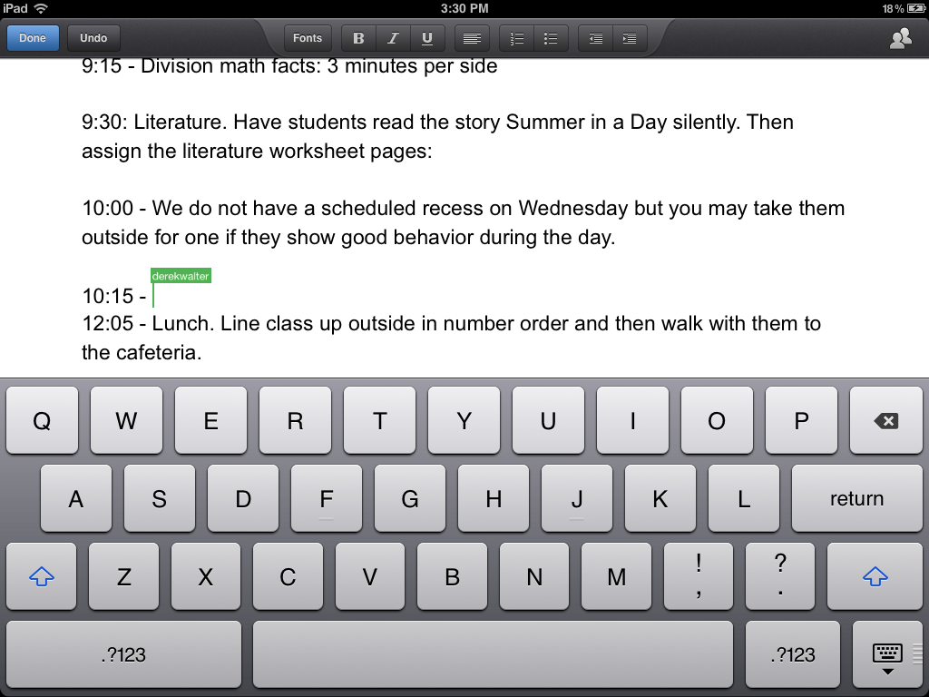


Students
in focus
Student: schedule across devices.
Student group: share files and collaborate.
Calendar (and Android)
Drive (and iOS)

Slide 13


