Slide 1
HuskyHunt 2013
Mindy Carpenter
Russell Jancewicz
All IT Staff Meeting November 21, 2013
Information Security Office

Slide 2
HuskyHunt: Security Awareness Training for Students
      innovative
      interactive
      online game
      use computer or mobile device
      earn points & win prizes
Information Security Office

Slide 3

HuskyHunt 2013
7
week scavenger hunt/online game
Second Year
Partnered with Husky Bucks One Card Office
Information Security Office

Slide 4
3
Modules
Security Awareness Module
Scavenger Hunt
?
Daily Questions
?
Information Security Office
Notes:
Game has three different “modules”
Cyber Security Awareness Learning Module- players read sshort learning module and take a quiz
Scavenger Hunt Module- clue is given to Husky One Card Vendor, first 20 or so players to find the poster wins giveaway, Incentives to promote and drive business to one card vendors
Daily Question Module: players can answer a daily question, keep involved in game, another way to earn points

Slide 5
Security Awareness Topics
PII & Spyware
Skybox
Internet & Social Media
Antivirus
Password Complexity & Protection
Phishing
Information Security Office

Slide 6
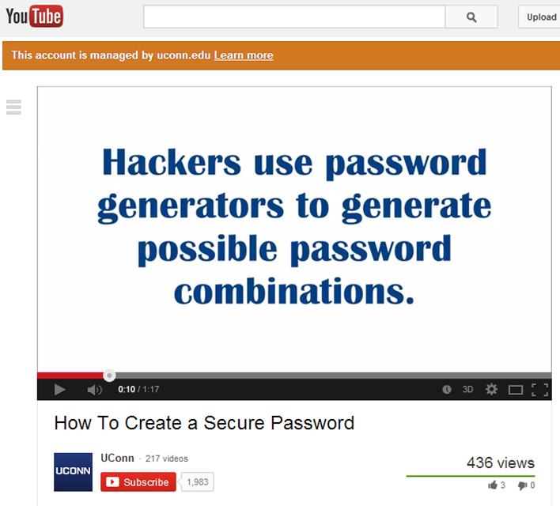

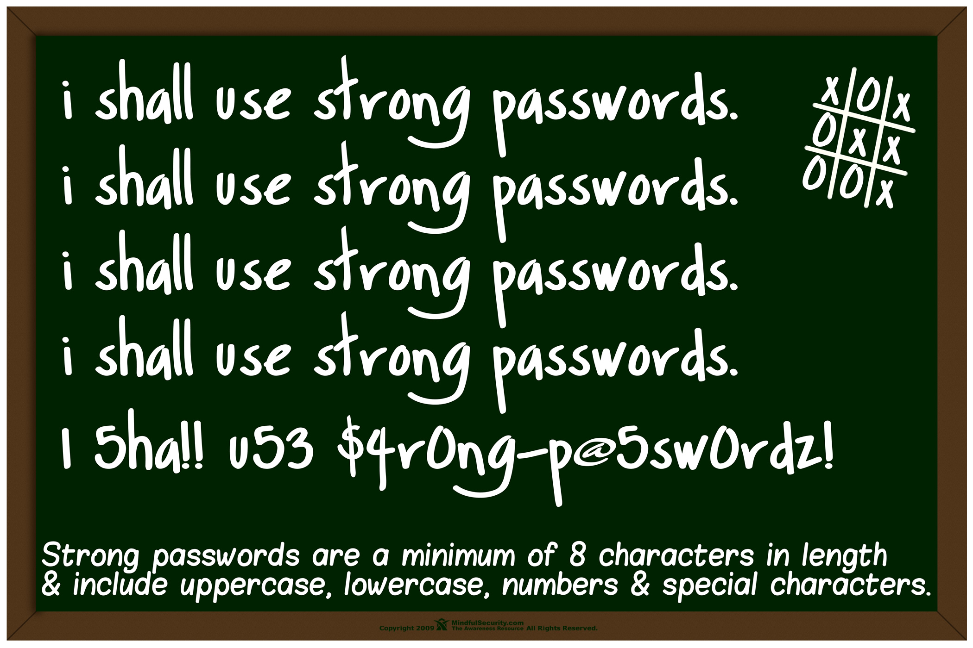
Examples of Content
Strong Passwords are Long and Complex. #UCONNHUSKYHUNT
Information Security Office

Slide 7
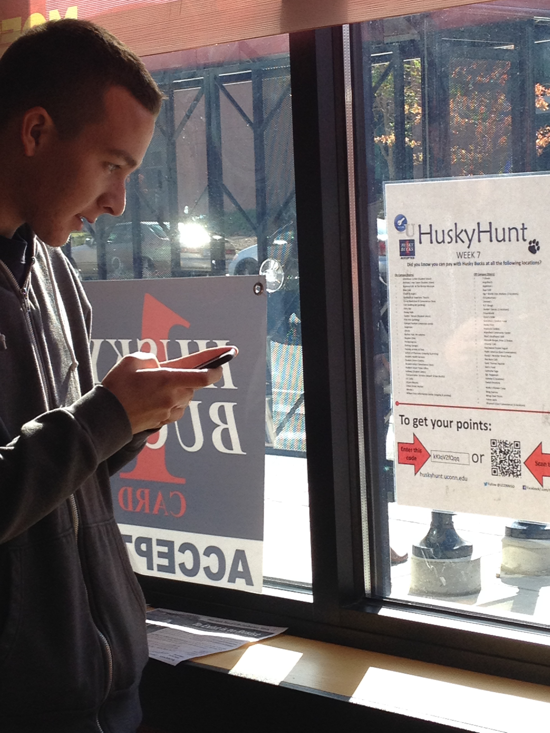
How to manage your Husky One Card
Where to use your Husky One Card
Information Security Office

Slide 8







Weekly giveaways from Husky One Card vendors:
3 Grand Prizes:
Information Security Office

Slide 9
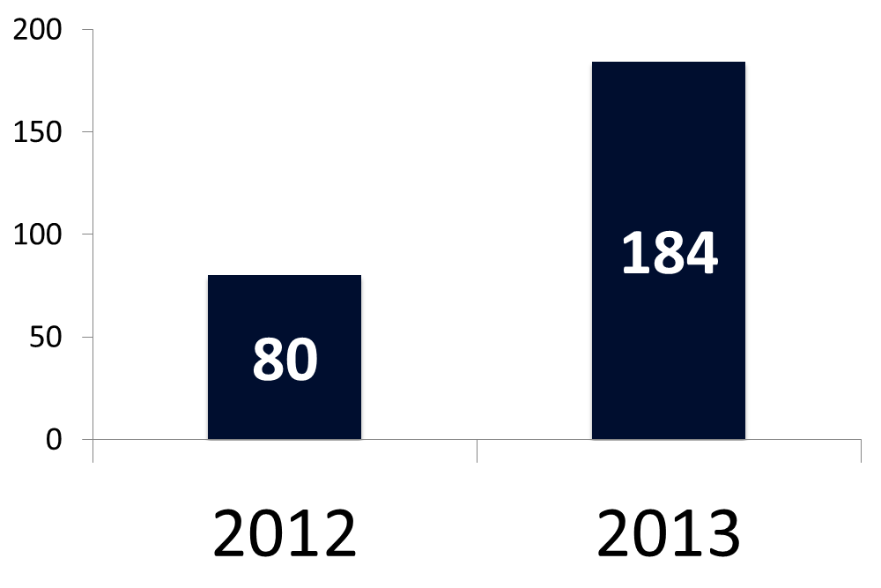
Played 1 or more learning module
Information Security Office

Slide 10
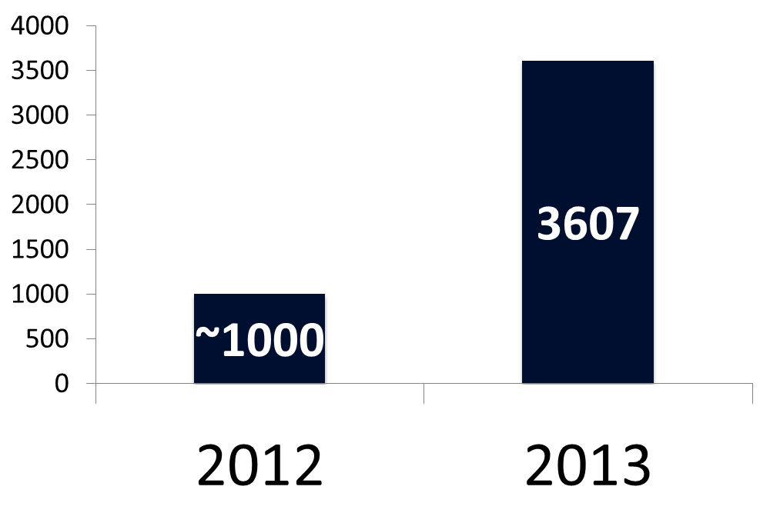
# of Posts and Tweets
Information Security Office

Slide 11
What went well:
Partnership with One Card Office
Growth in # of players completing modules
Matured process- administration and implementation of game
Information Security Office

Slide 12
Improvements for next time:
3 week game in April
Sustain marketing throughout
Dynamic Point System
Work on engaging content
First Year Experience Curriculum
Information Security Office

Slide 13
Leveraged HuskyHunt
IE Zero Day Exploit announcement
Skybox
    Learning Module and an extra bonus give-away
HuskyTech
Information Security Office

Slide 14
Future Collaboration:
Other UConn services/programs
Code is now open source
Looking to collaborate with other schools
Information Security Office

Slide 15
huskyhunt.uconn.edu/game
Information Security Office

