Slide 1
Hi-Tech Classroom Replacement Cycle Update
Lance Nye
January 2015

Slide 2
Agenda
Where we started
The Change
Where we are now

Slide 3
Where We Started
Three types of classrooms
Oldest Classroom = 14 years old
Partial integration with IP based monitoring systems.
33% Digital Integration.
Upgrades came from any end of year available money.
These funds historically went to new rooms, not upgrading old classrooms.

Slide 4
The Change
Discussion with Network Director and CIO
Worked with UITS Business Department to develop a seven (7) year recycle plan.
Classroom Plan’s approved through UCONN Classroom Committee.
Classroom PC’s will be on a three (3) recycle program.

Slide 5
The Change
Upgrade 42 classrooms
50% of those have no current Audiovisual Equipment.
Budget: $1.8M

Slide 6
The Benefits
Laser Projectors – No Lamps, reduced total cost of ownership.
Managed Switch – No longer need to pull six data jacks into classrooms.
All-in-one switcher, controller, amplifier.
Integration with AMX classroom management system.
Scheduled shutdown – saved equipment life and energy costs.

Slide 7
The Benefits
High Density Access Points
Facilities Operations updating physical classroom features.

Slide 8
Thank You!
Denise Irmscher of the Business Department, Working along side and creating the “Living Excel Document”
The UITS Business Team, thank you for getting all of the classroom upgrade paperwork out to purchasing.
Michael Mundrane, thank you for getting us a sustainable budget.

Slide 9
Thank You!
Network Engineering, Thank you for assisting with configuration of network switches, wireless access points & cabling runs.
Audiovisual Technologies Team, thank you for assistance with overseeing the installations, training, and support of the current, upgraded, and new Hi-Tech Classrooms.

Slide 10
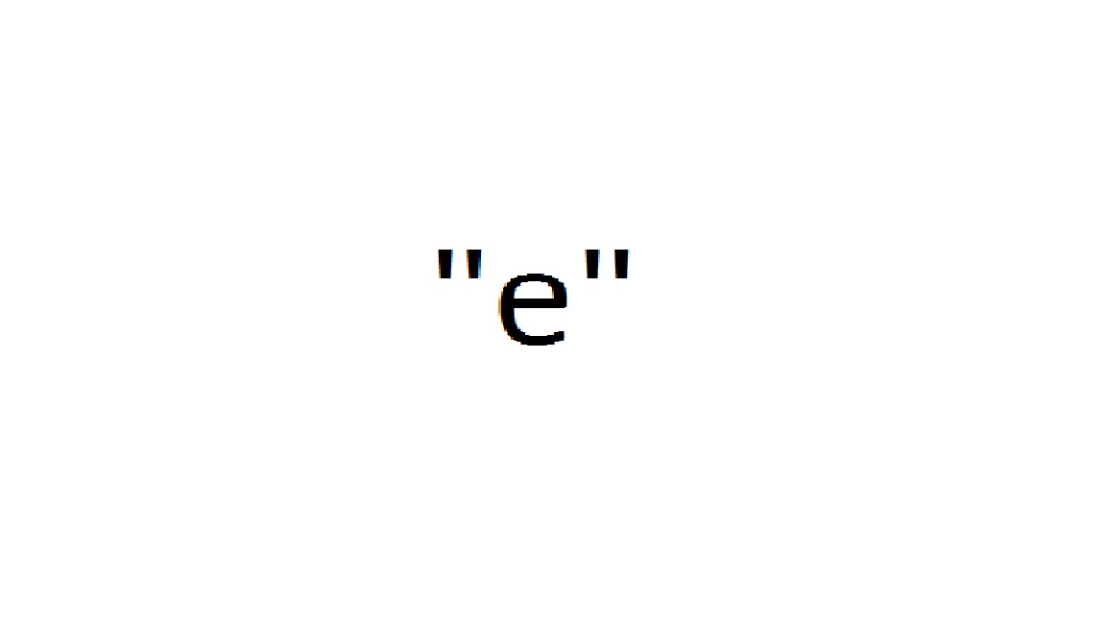
Question & Answers

